Slide 1

Topic 5
Java Operators

Slide 2
Identifiers

Slide 3
Identifiers
An identifier is a name that is used to refer to a variable or method. This can contain:
Letters (including some special characters)
Numbers (0123456789)
Underscore ( _ )
They cannot:
Start with a number
Contain dots (.), stars (*), or special characters like (@!&%)
Be a reserved word (List)

Slide 4
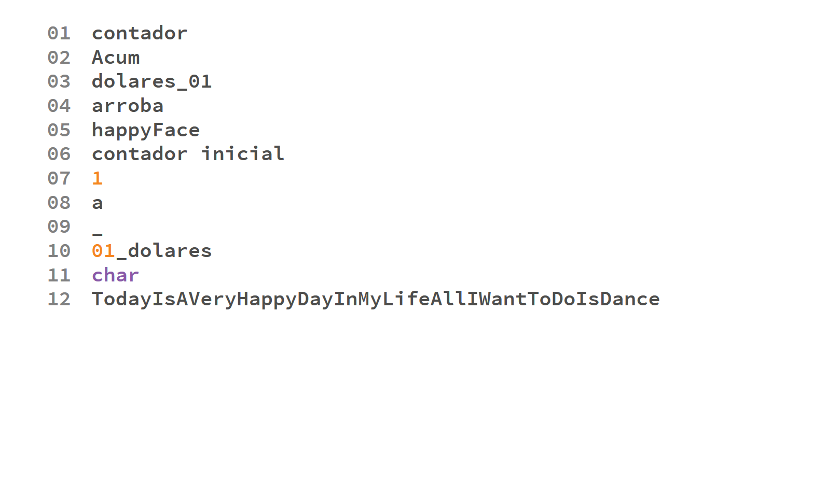

Slide 5
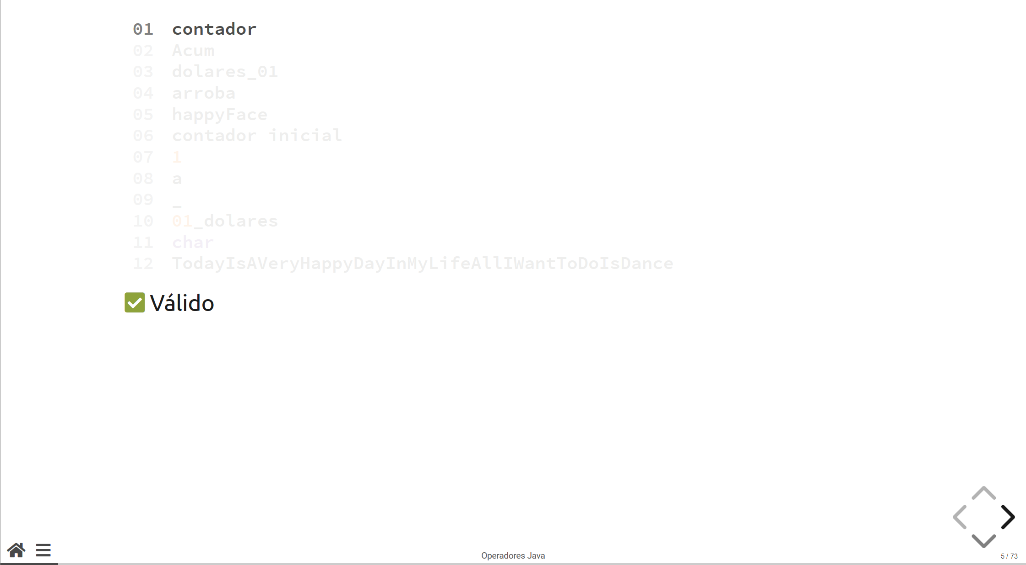
Valid

Slide 6
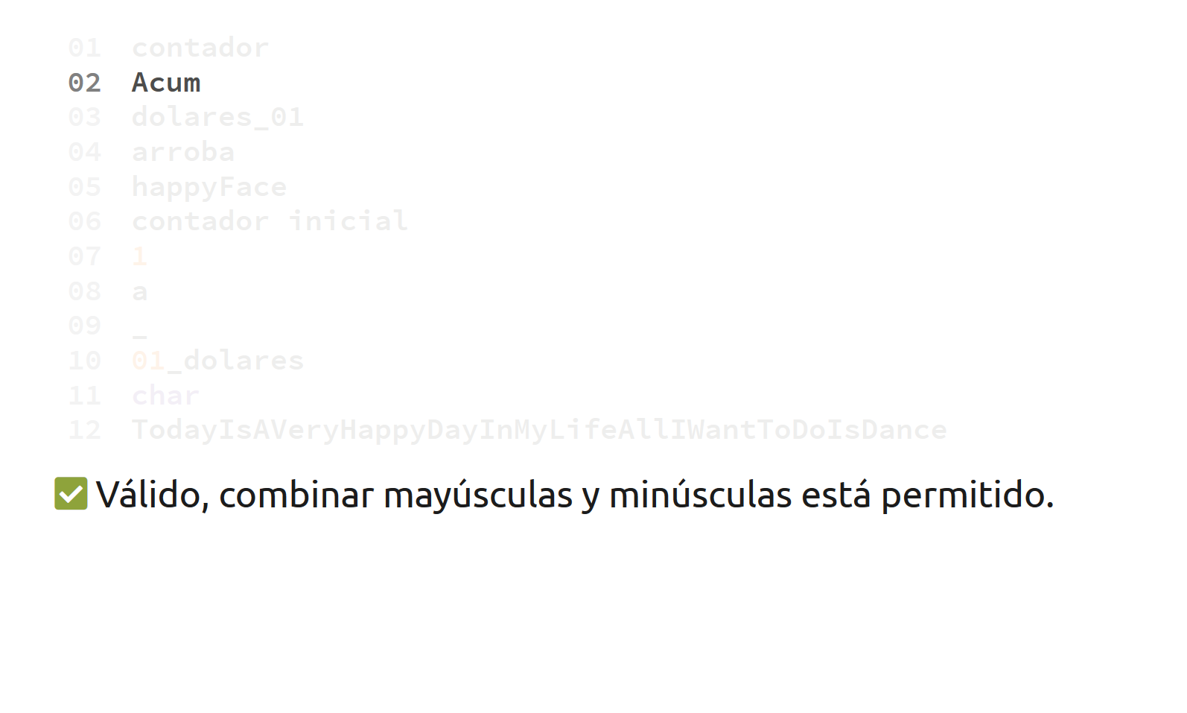
Valid, combining upper and lowercase is allowed

Slide 7
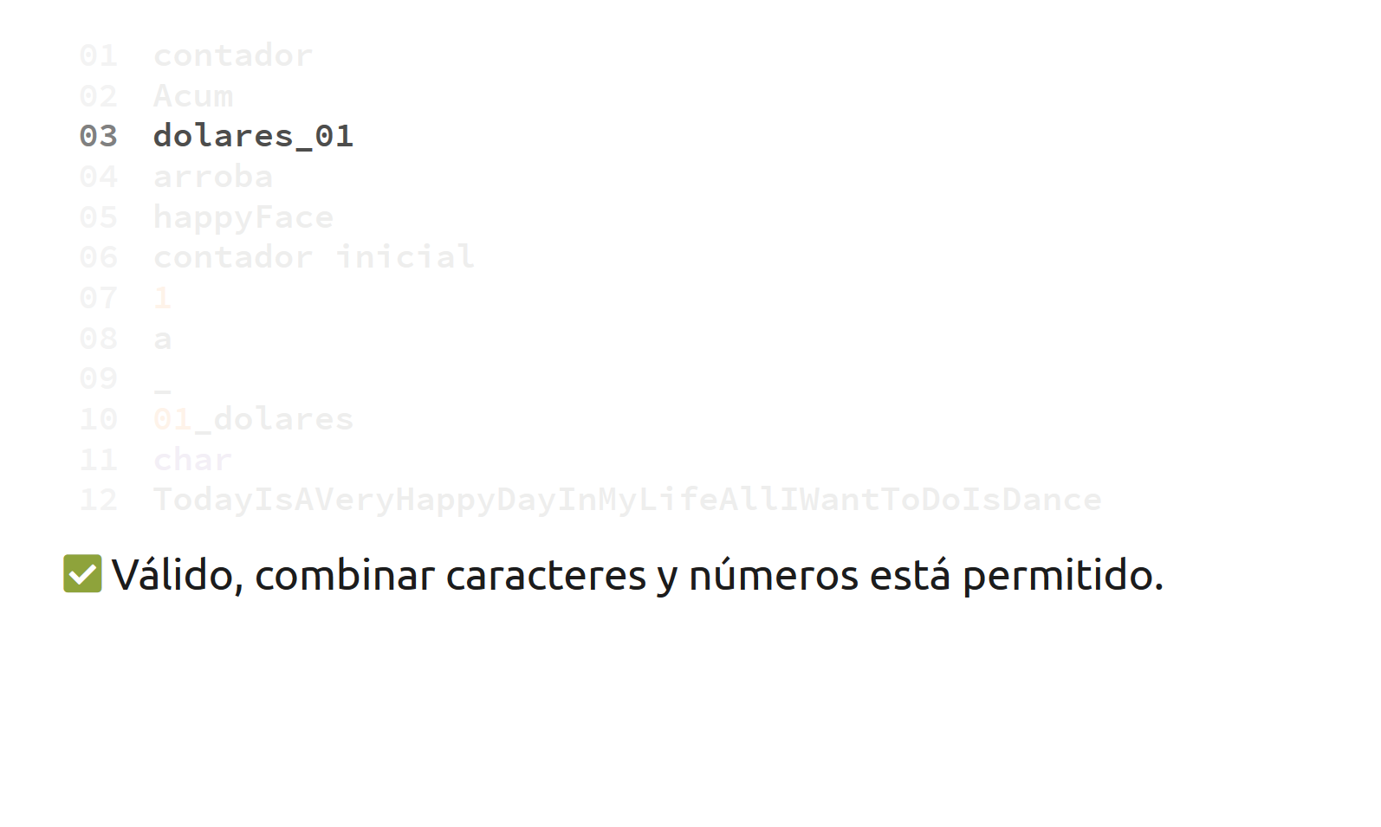
Valid, combining underscores, letters and numbers is permitted

Slide 8
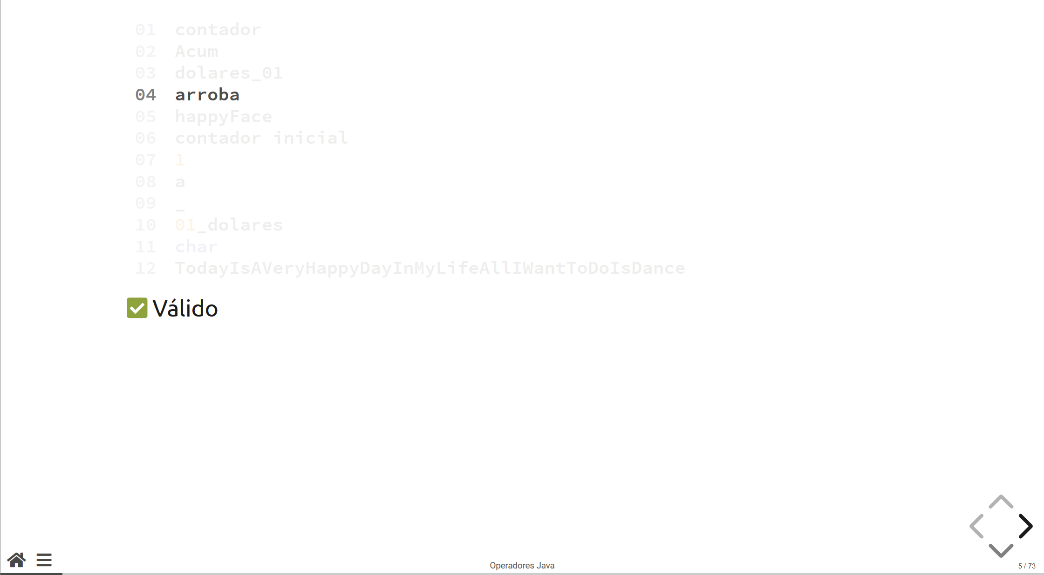
Valid

Slide 9
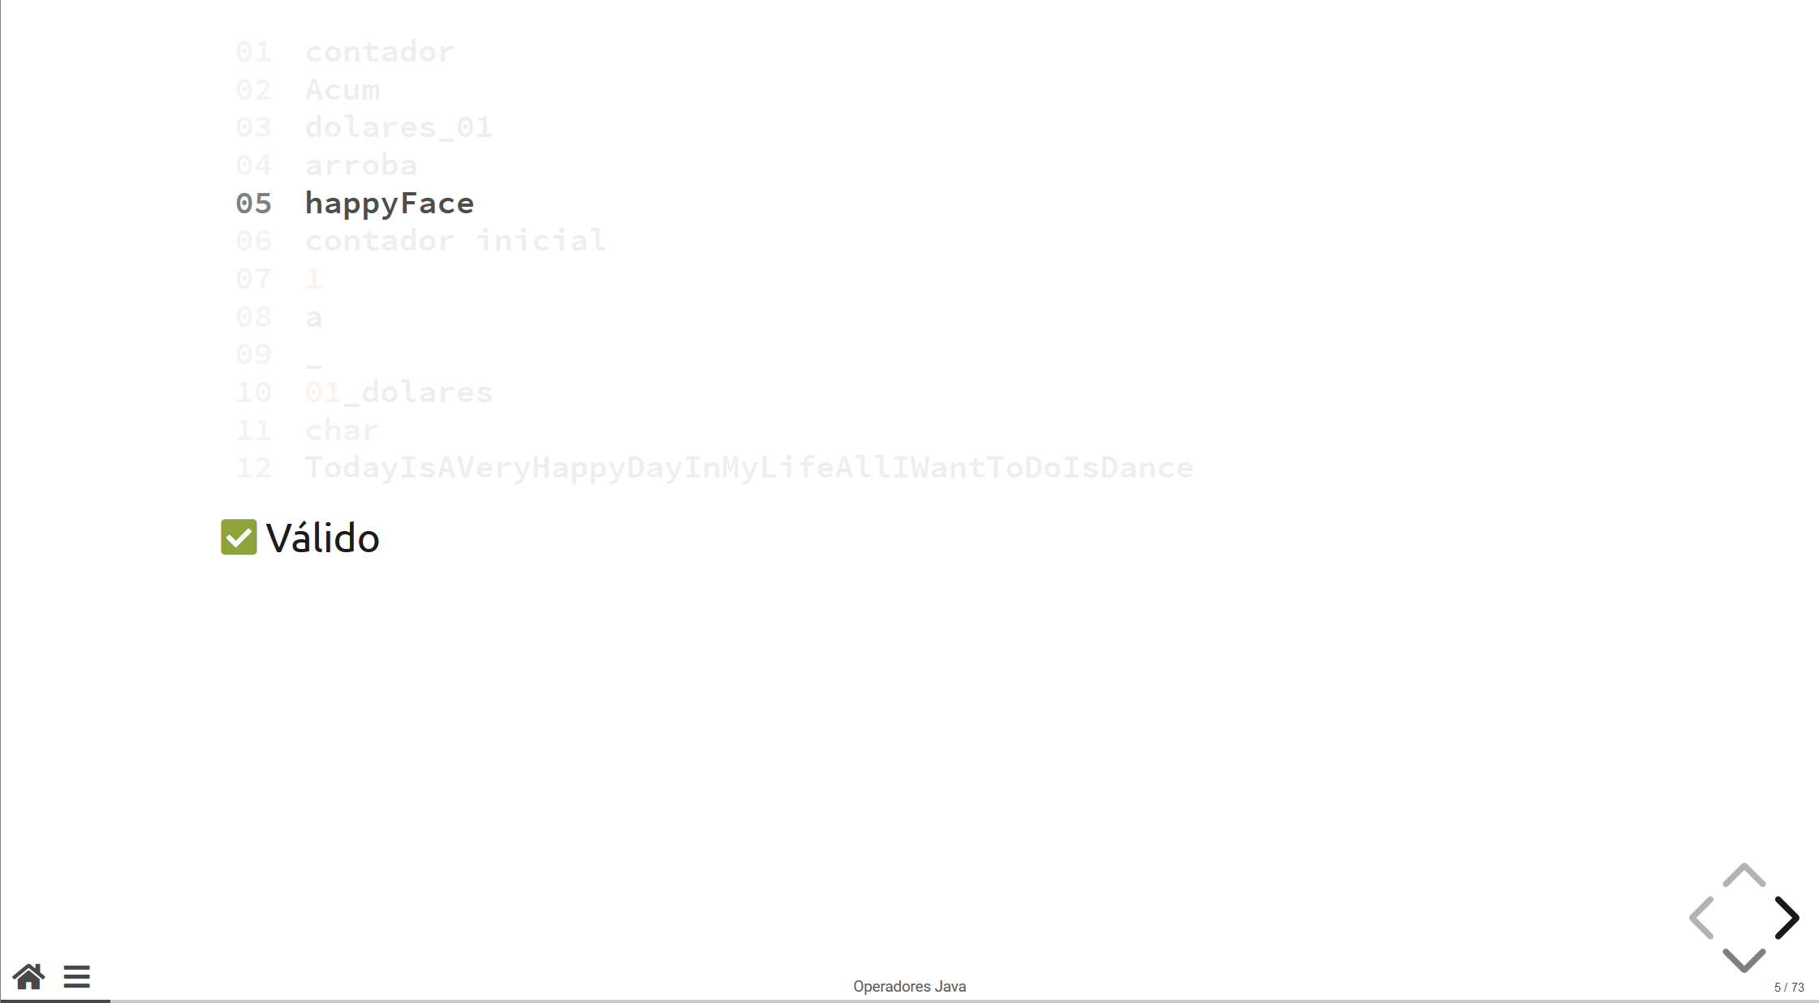
Valid

Slide 10
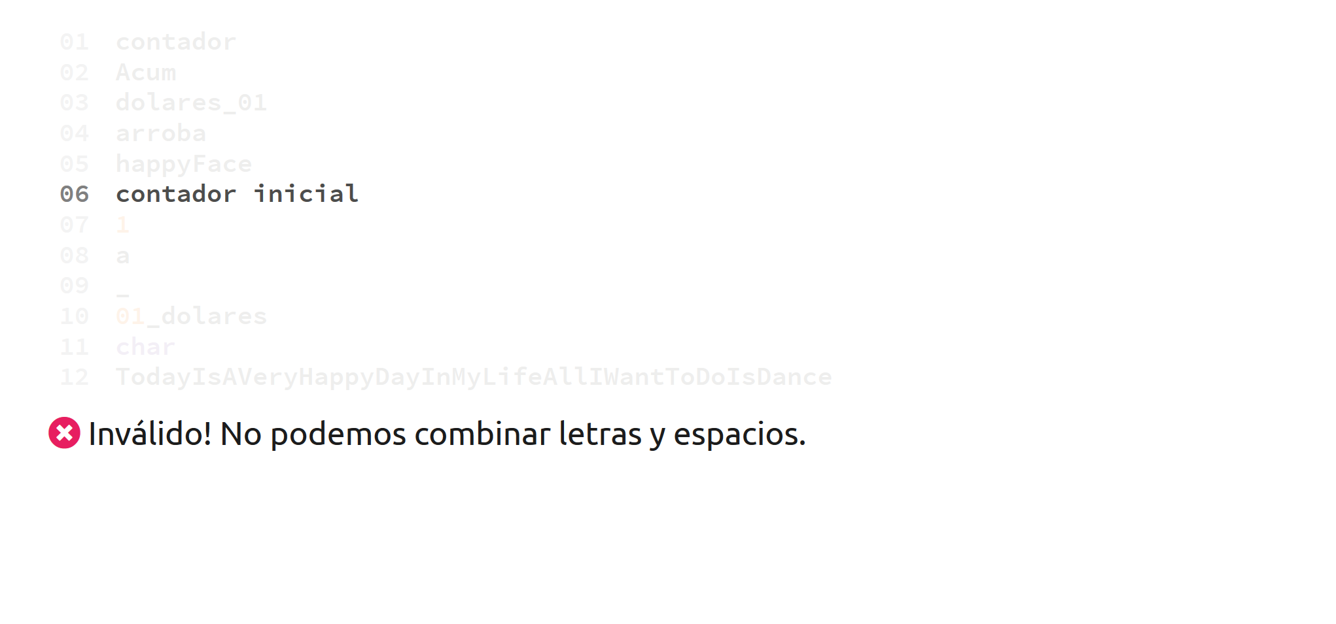
Invalid! Whitespaces cannot be part of an identifier

Slide 11
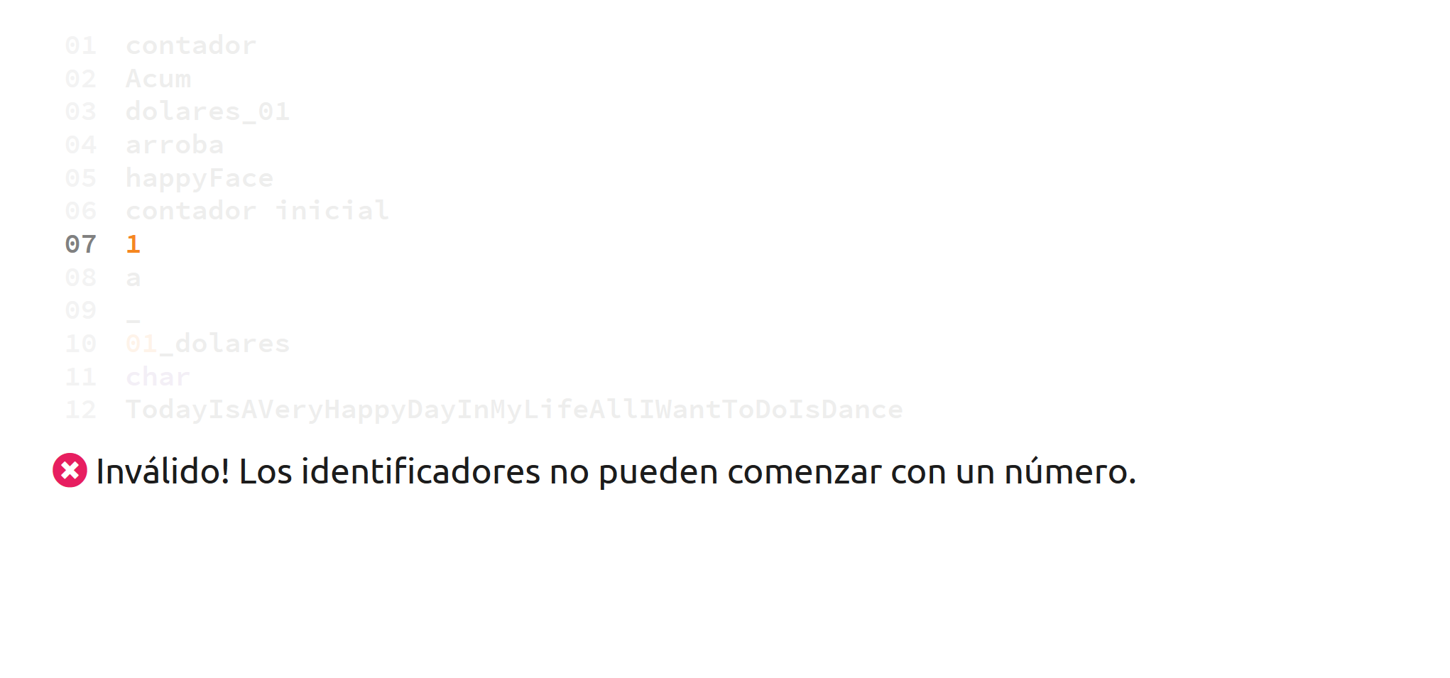
Invalid! A number by itself is not a valid identifier

Slide 12
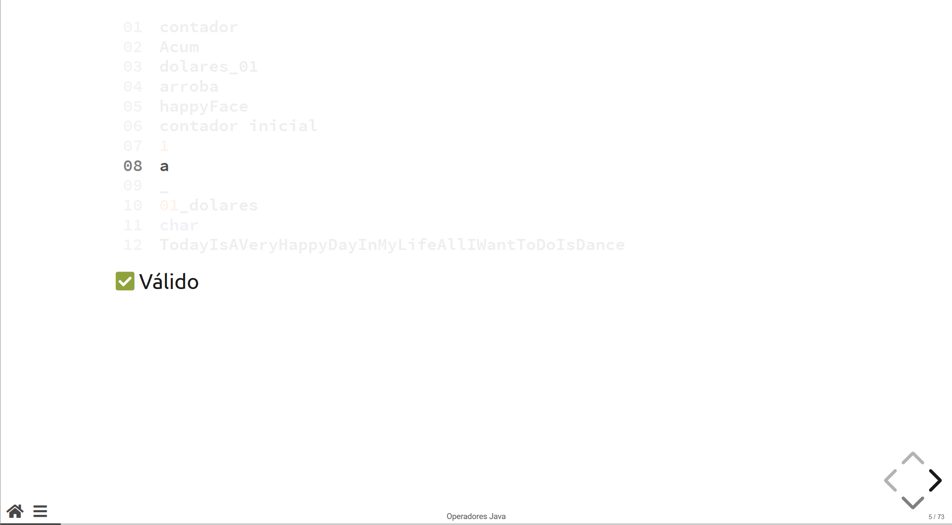
Valid

Slide 13
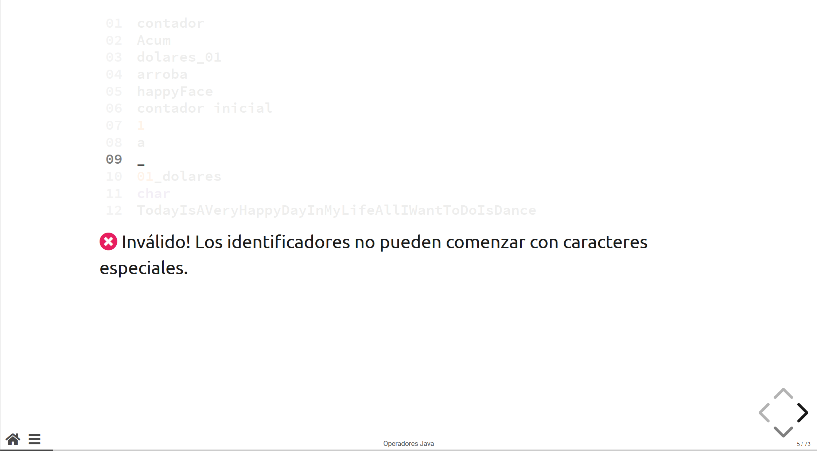

Invalid! A special character by itself is not a valid identifier

Slide 14
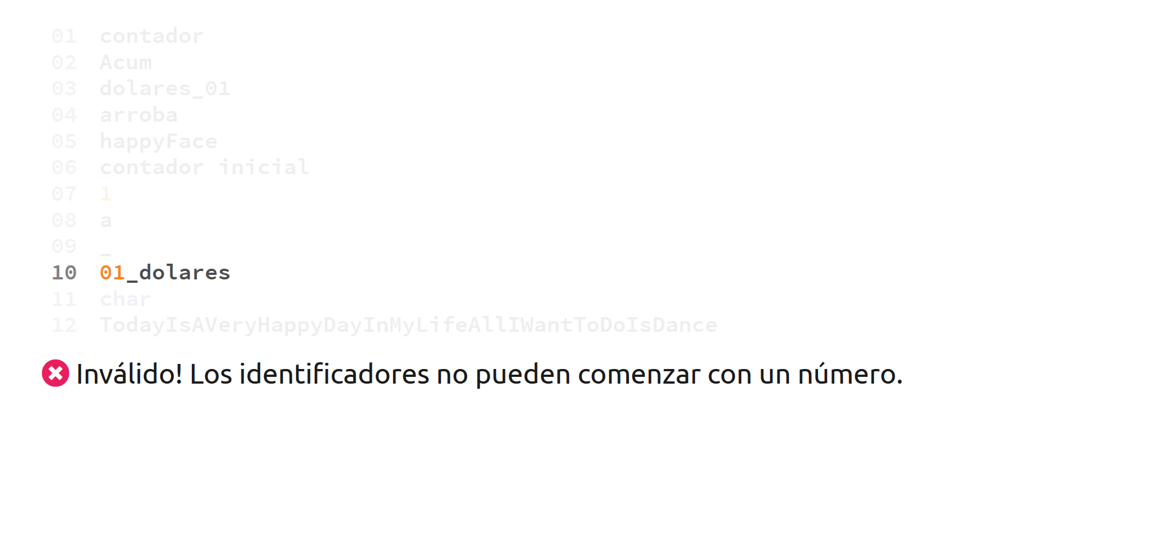
Invalid! Identifiers cannot start with a number

Slide 15
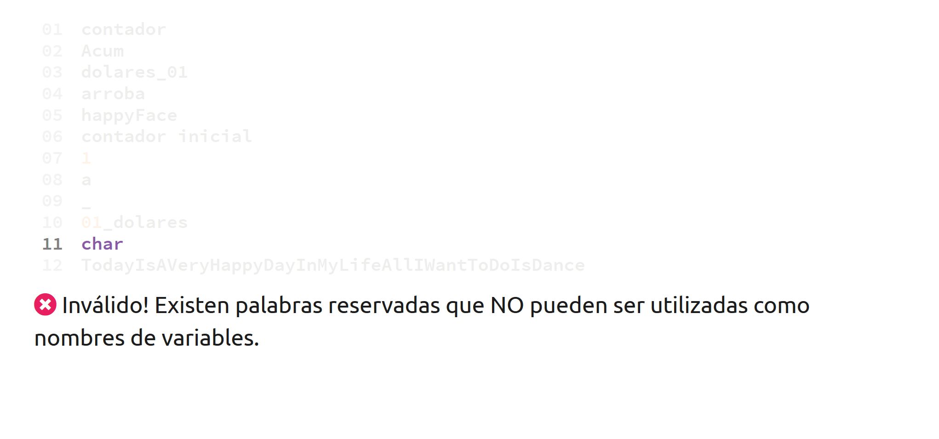
Invalid! Char is a reserved word in the Java programming language. Therefore, it cannot be used to name a variable.

Slide 16
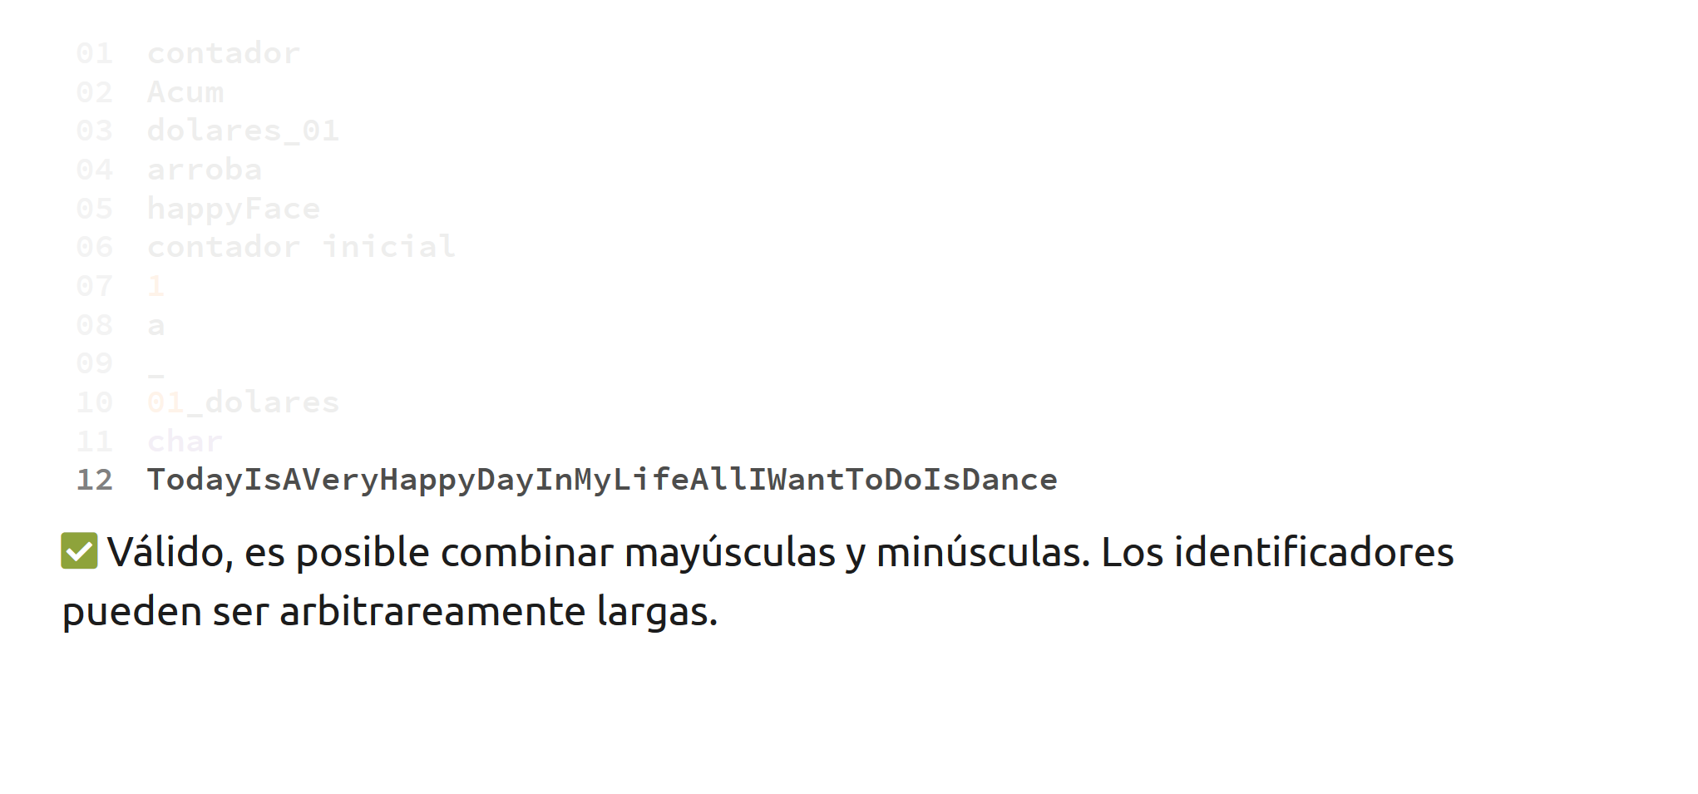
Valid! Identifiers can be as long as you want them to be.

Slide 17
Variables

Slide 18

Variables
A variable is the unión of a data type and an identifier, and it allows us to store information. In Java, variabes store information in RAM.

Slide 19
Variables
A variable goes through two phases:
Declaration: We specify a data type (int, char, String).
Assignment: We use the assign symbol (=) to assign a value.
A variable always has to be declared before it can be used.

Slide 20
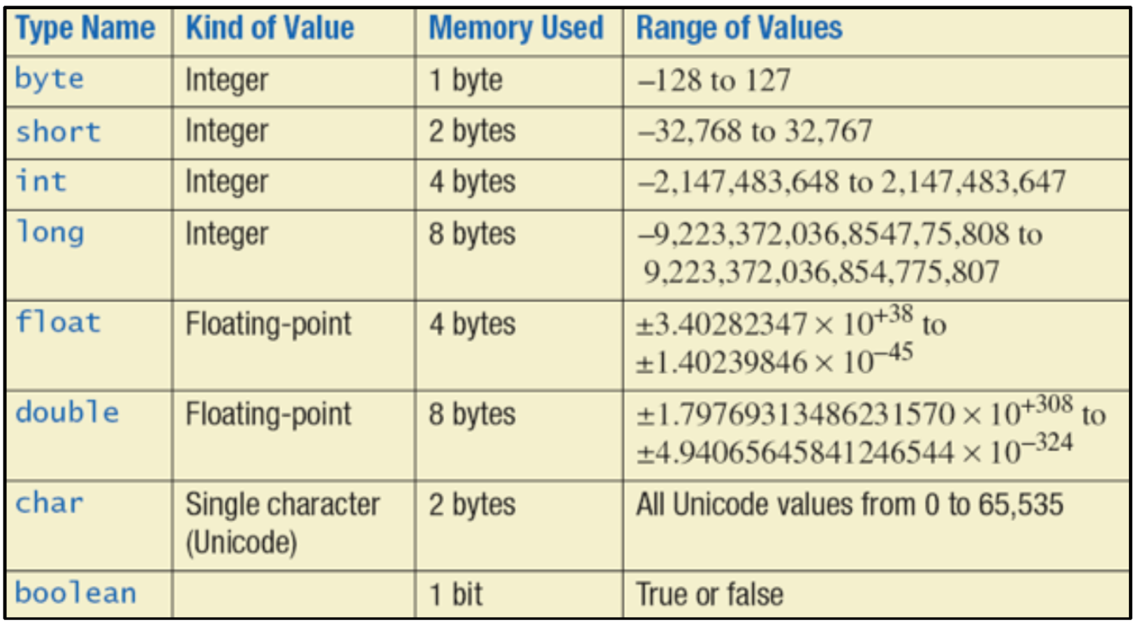

Slide 21


Primitive Data Types
Primitive data types are the most basic data types in Java. By combining this data types, we can represent any strucutre, game, video or object we can think of.

Slide 22
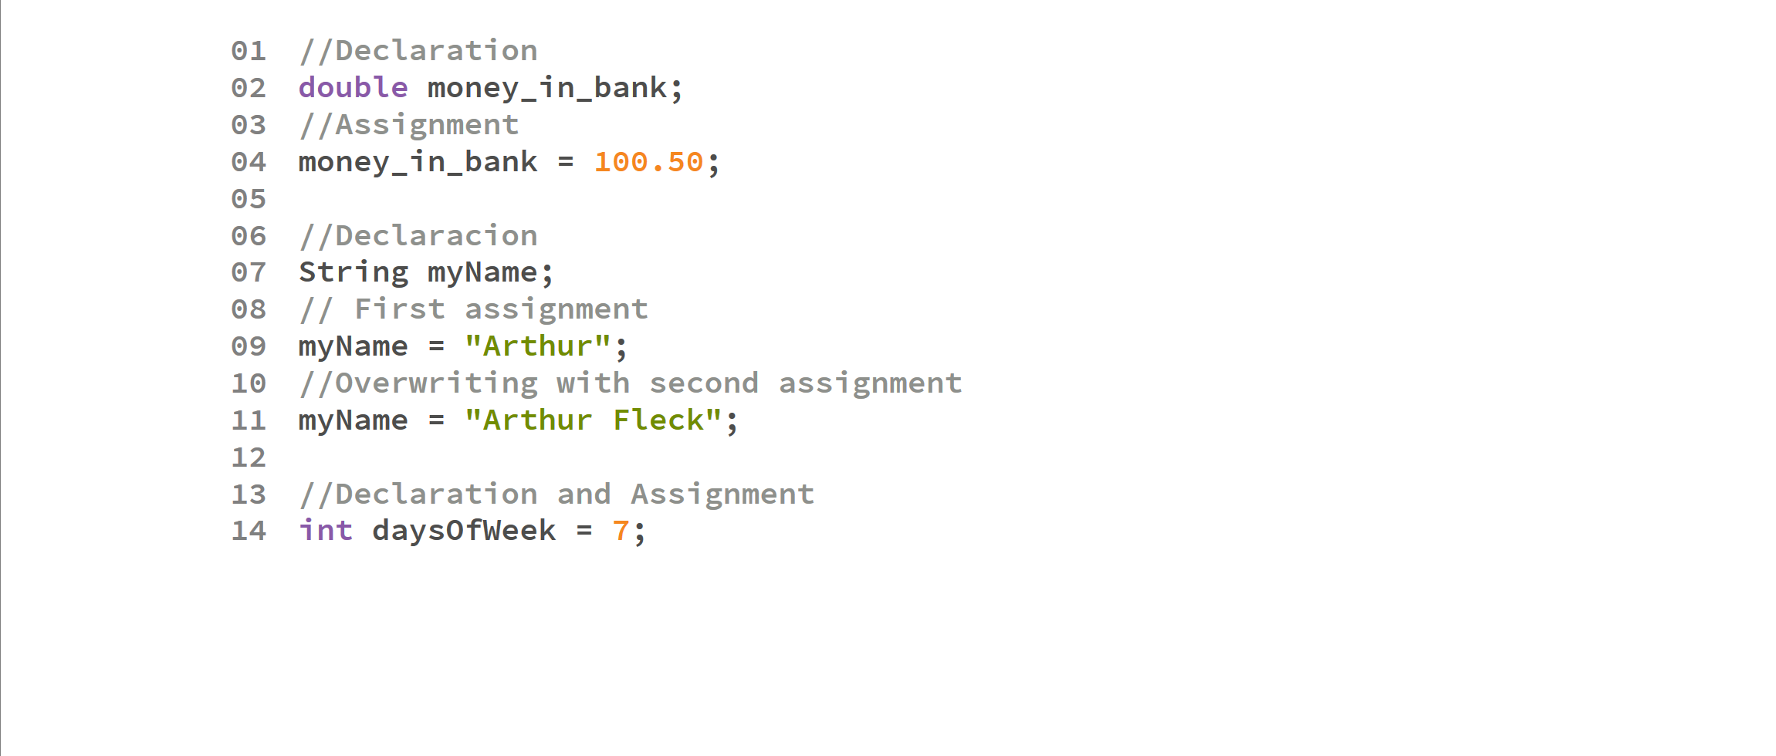

Slide 23
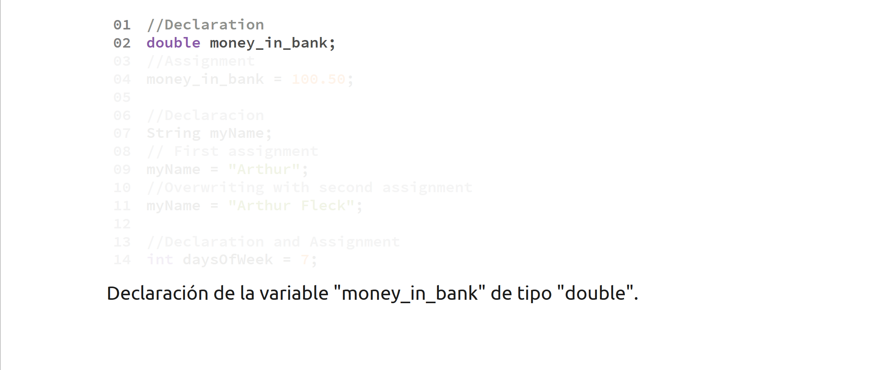
Variable money_in_bank is declared as a double

Slide 24
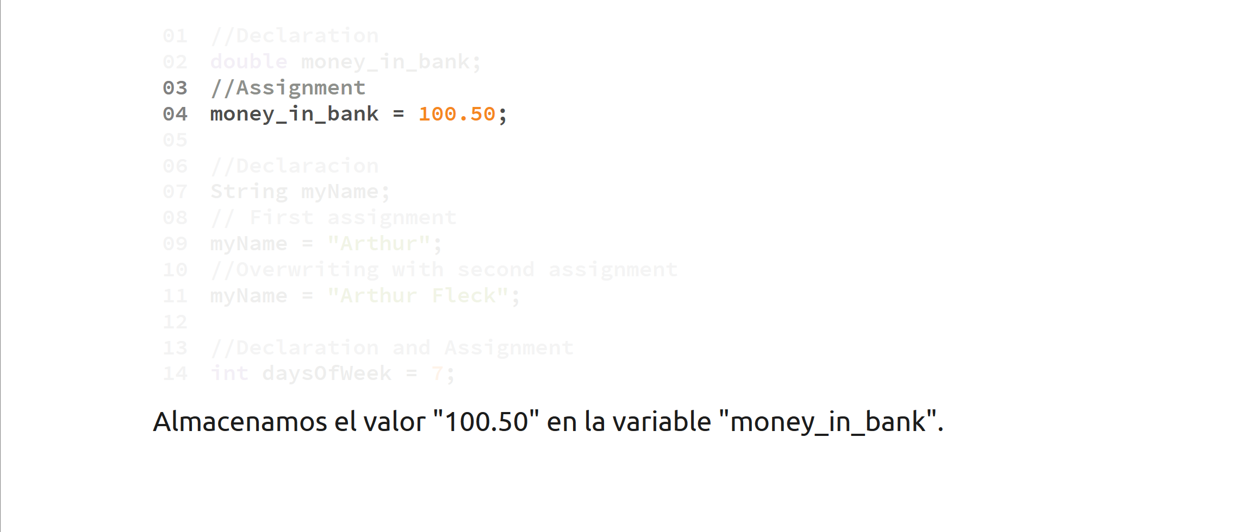
A value of 100.50 is assigned to a double variable

Slide 25
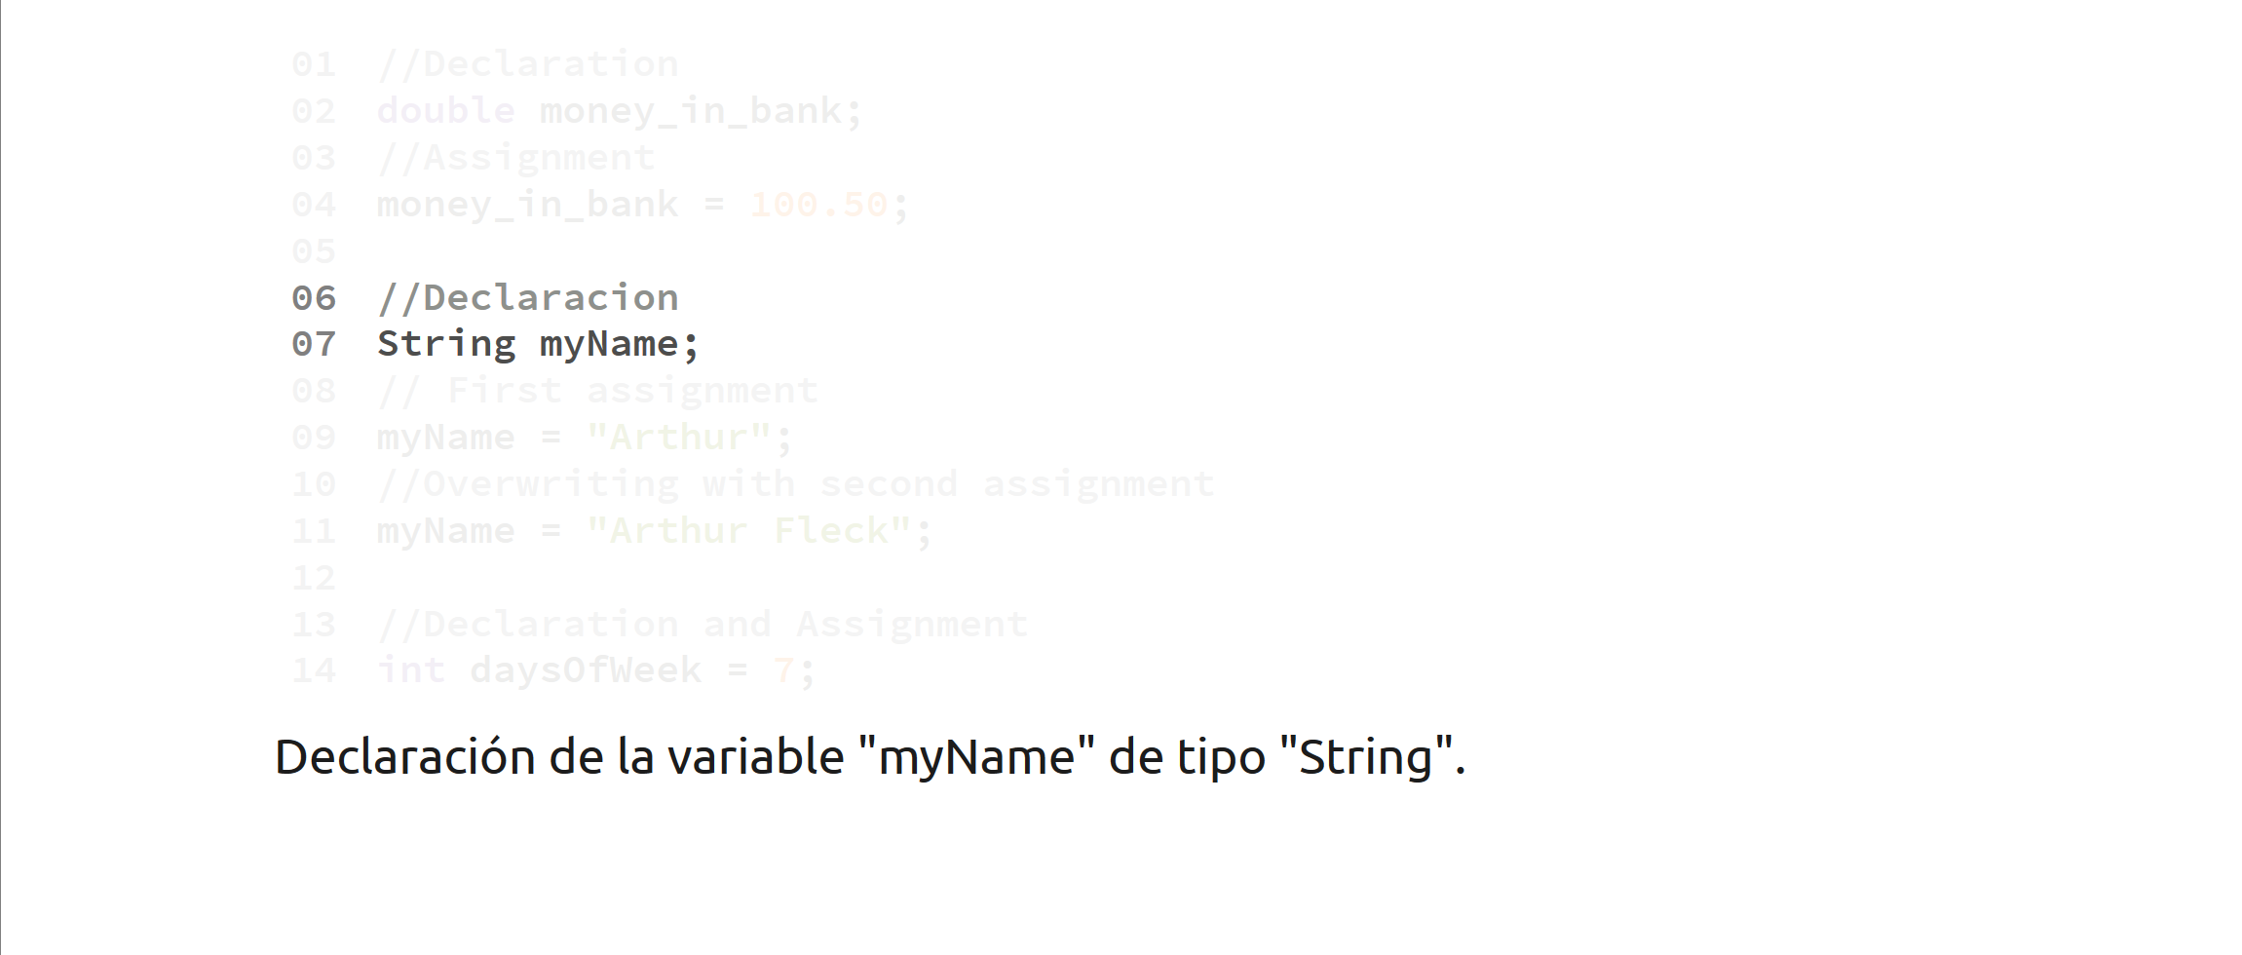
Variable myName is declared

Slide 26
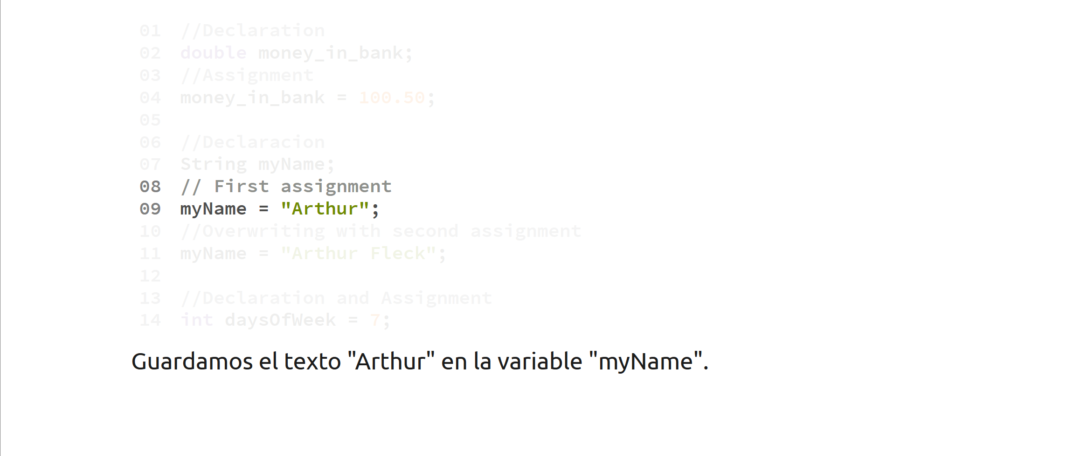
The text “Arthur” is stored on variable myName

Slide 27
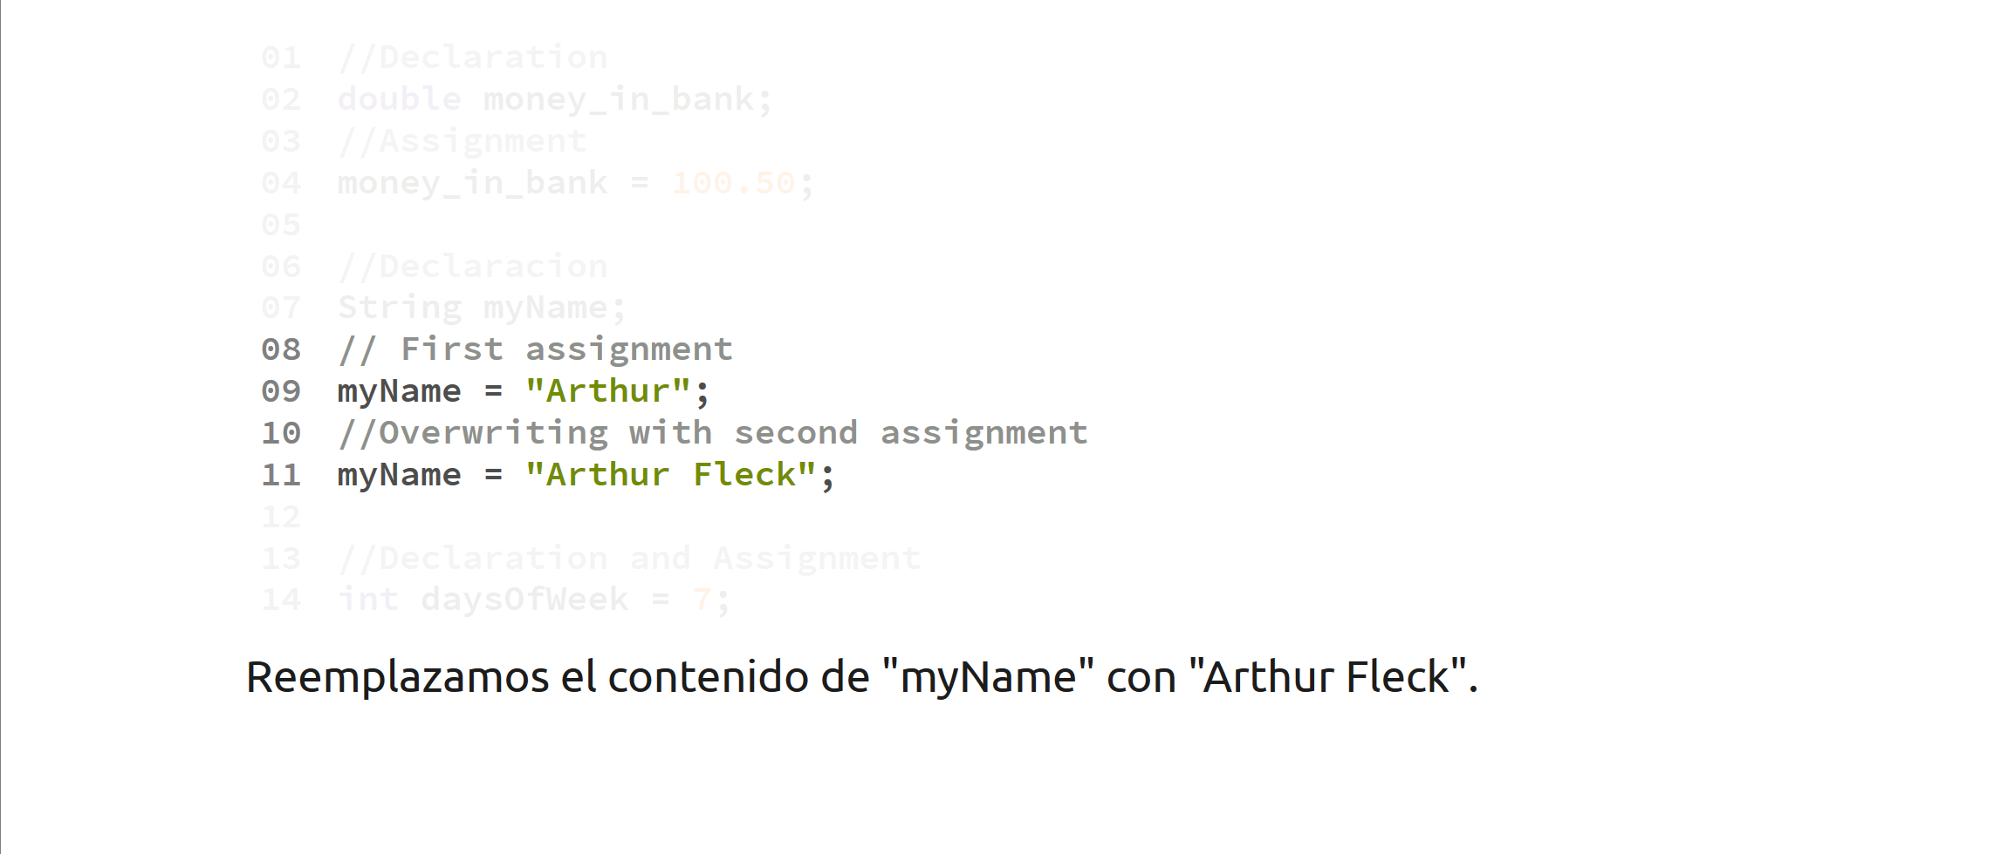
After the second assignment, the value in myName will be overwritten by “Arthur Fleck”

Slide 28
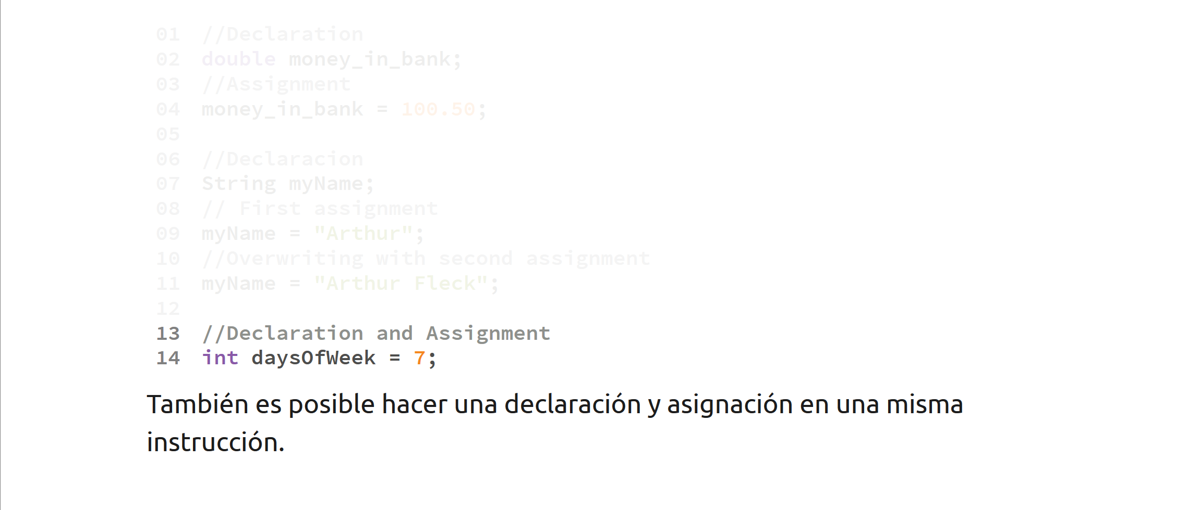
Declaring and assigning a variable is also possible a single instruction.

Slide 29
Operators

Slide 30
Arithmetic Operators
We can form arithmetic operations using the following symbols
Addition ( + )
Subtraction ( - )
Multiplication ( * )
Division ( / )
Module or remainder ( % )

Slide 31
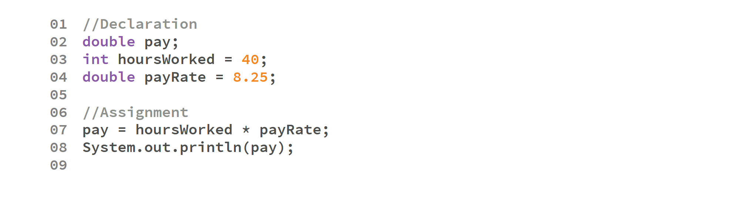
Output:
330.0

Slide 32

Output:
330.0
Initial declarations

Slide 33
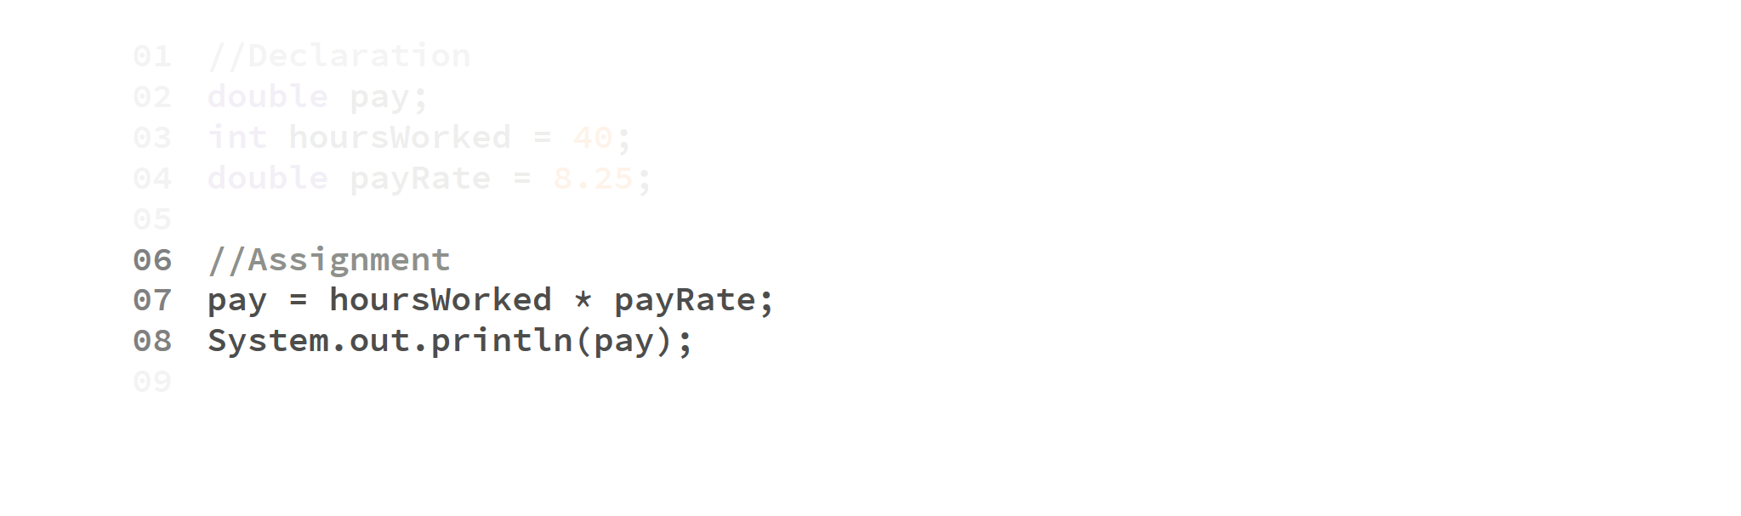
Output:
330.0
We multiply hoursWorked and payRate, assign the result to pay

Slide 34

Output:
330.0

Slide 35
Division
When we divide two integer variables (int), it is considered integer division. By that end, its result will be truncated:
int a = 9;
int b = 2;
int result = a / b;
System.out.println(result);
Output:
4

Slide 36
Even when the result is stored on a double variable.
int a = 100;
int b = 99;
double result = a / b;
System.out.println(result);
Output:
1.0

Slide 37


This can be fixed by changing at least one operand to a double.
double a = 3;
int b = 2;
double result = a / b;
System.out.println(result);
int a = 3;
int b = 2;
double result = a / b;
System.out.println(result);
Output:
1.5
Output:
1.0
double a = 3;
double b = 2;
double result = a / b;
System.out.println(result);
double result = 3.0 / 2.0;
System.out.println(result);
Output:
1.5
Output:
1.5

Slide 38
Java has well-defined rules for evaluating expressions, including operator precedence, operator associativity, and order of operand evalution. We describe each of these three rules.
Operator precedence. Operator precedence specifies the manner in which operands are grouped with operators. For example, 1 + 2 * 3 is treated as 1 + (2 * 3), whereas 1 * 2 + 3 is treated as (1 * 2) + 3 because the multiplication operator has a higher precedence than the addition operator. You can use parentheses to override the default operator precedence rules.
Operator associativity. When an expression has two operators with the same precedence, the operators and operands are grouped according to their associativity. For example 72 / 2 / 3 is treated as (72 / 2) / 3 since the division operator is left-to-right associate. You can use parentheses to override the default operator associativity rules.
Most Java operators are left-to-right associative. One notable exception is the assigment operator, which is right-to-left associative. As a result, the expression x = y = z = 17 is treated as x = (y = (z = 17)), leaving all three variables with the value 17. Recall that an assignment statement evaluates to the value of its right-hand side. Associativity it not relevant for some operators. For example, x <= y <= z and x++-- are invalid expressions in Java.

Slide 39
Bloques

Slide 40
Bloque
Un bloque es una sección de código encapsulada por llaves { }.
Un bloque sirve para indicar el inicio y fin de algún grupo de instrucciones. Cada llave de apertura debe ser posteriormente cerrada por una llave opuesta:

Slide 41
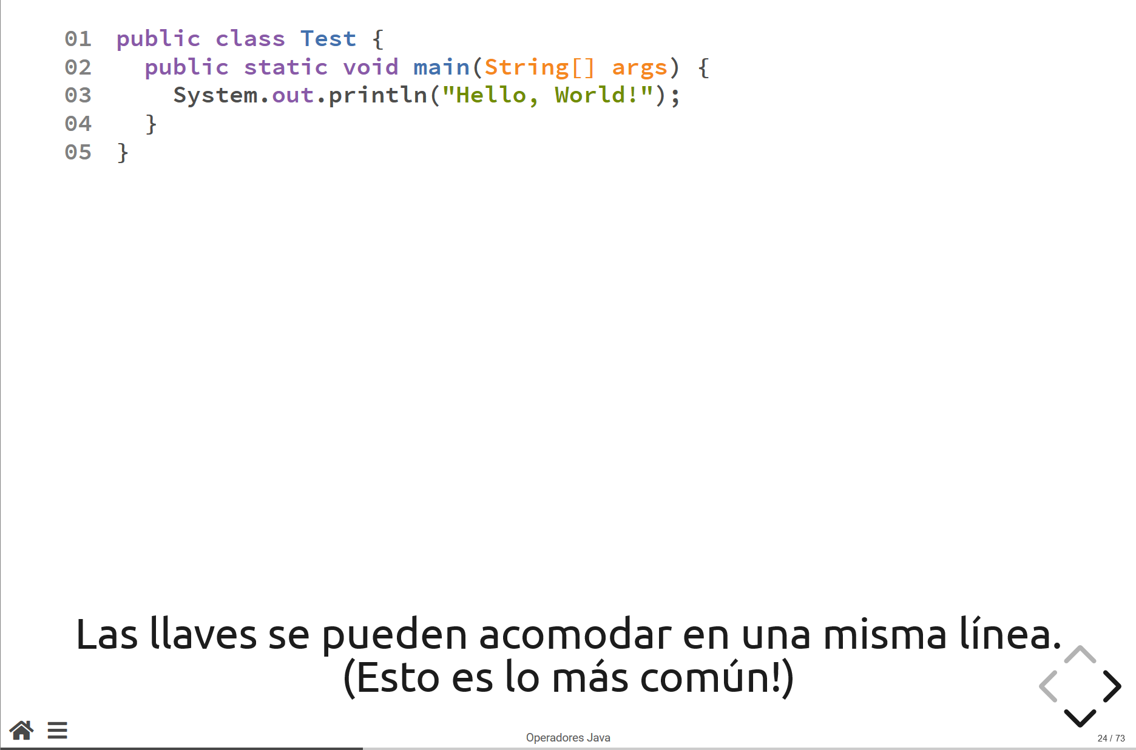

Slide 42
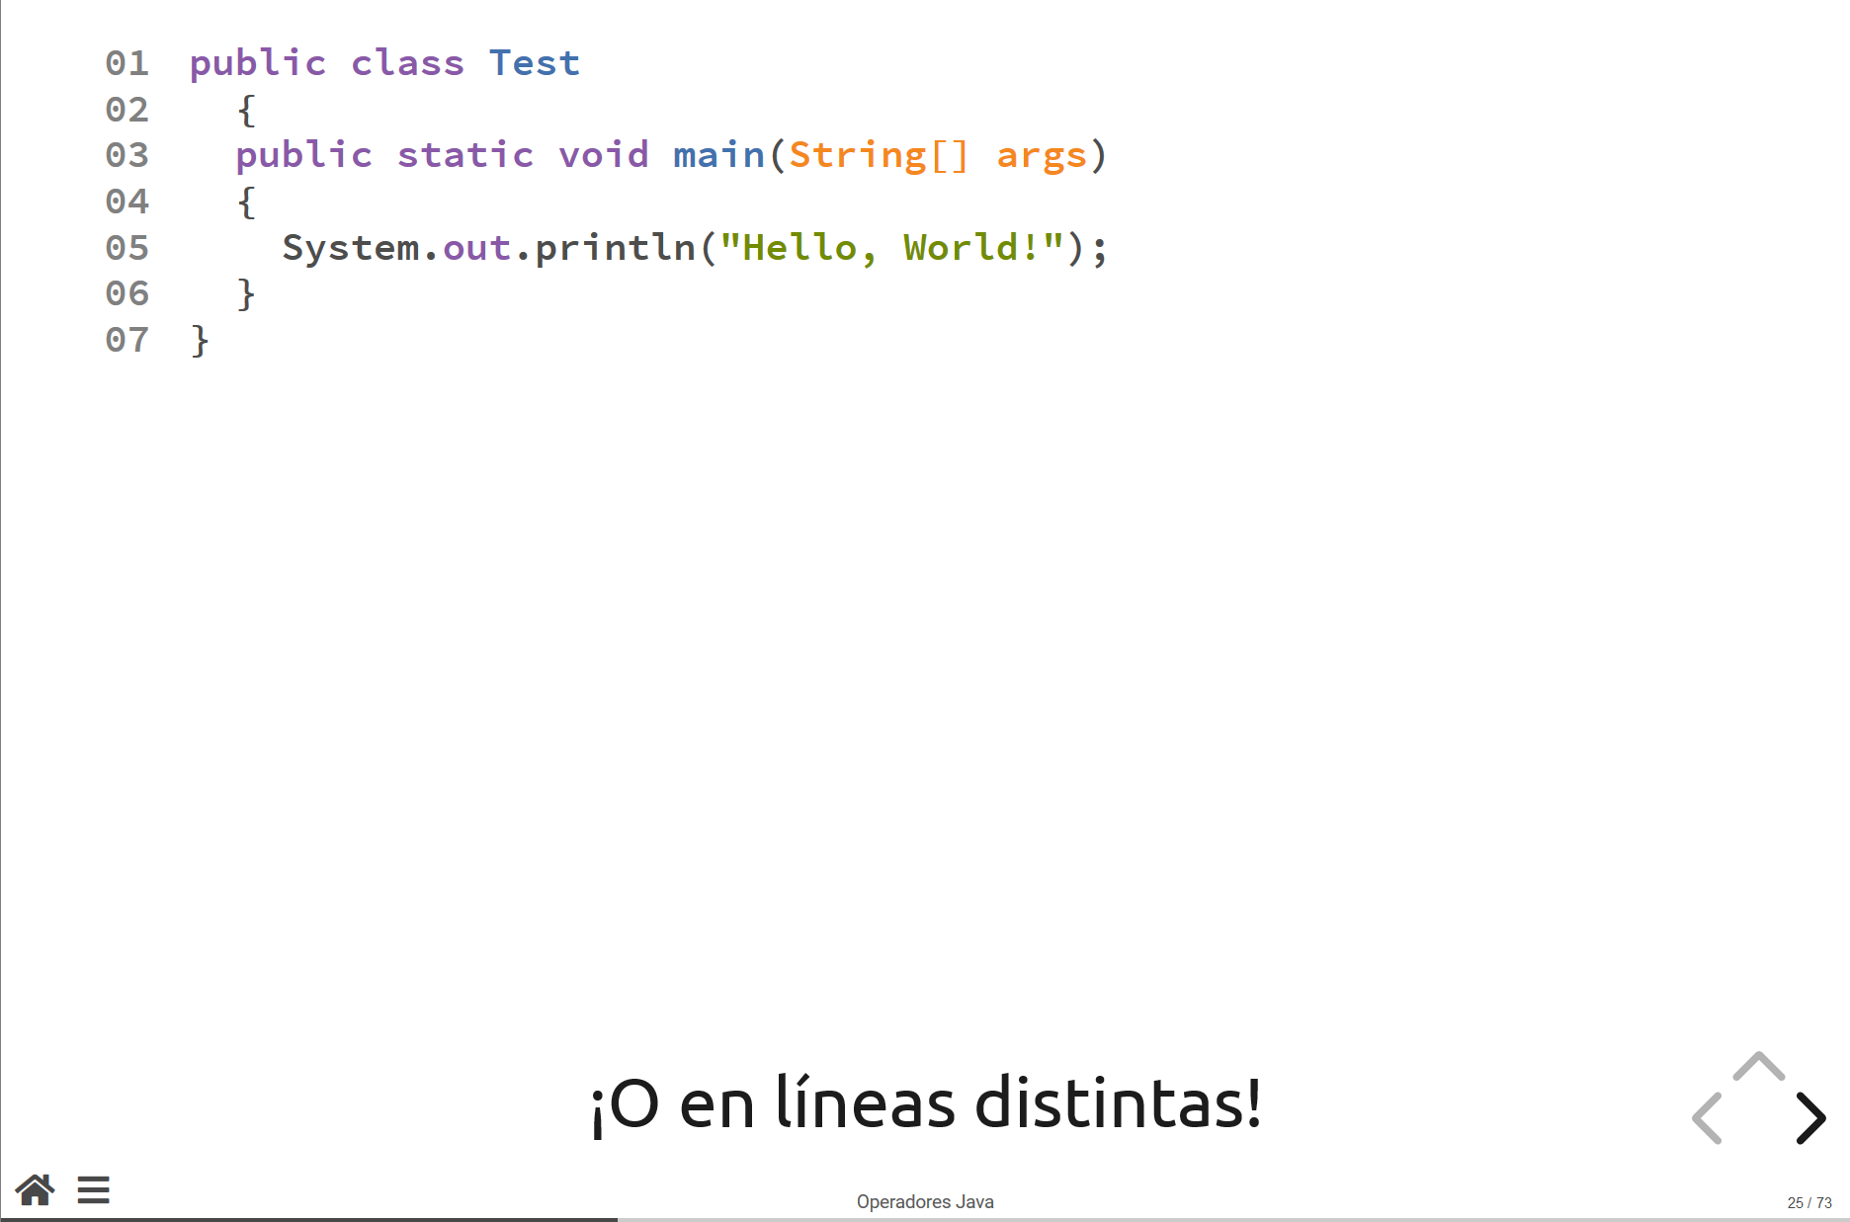

Slide 43
Clase Scanner
Lectura del teclado

Slide 44
Clase Scanner
La clase Scanner es una librería de instrucciones que permiten al programador leer información del teclado a través de la consola.
Cuando queremos incorporar librerías externas a alguna clase, necesitamos agregar la referencia a la clase que deseamos importar utilizando la instrucción import.
import java.util.Scanner;
De esta forma, toda la funcionalidad de la clase Scanner se incluye al programa en el que estamos trabajando.

Slide 45
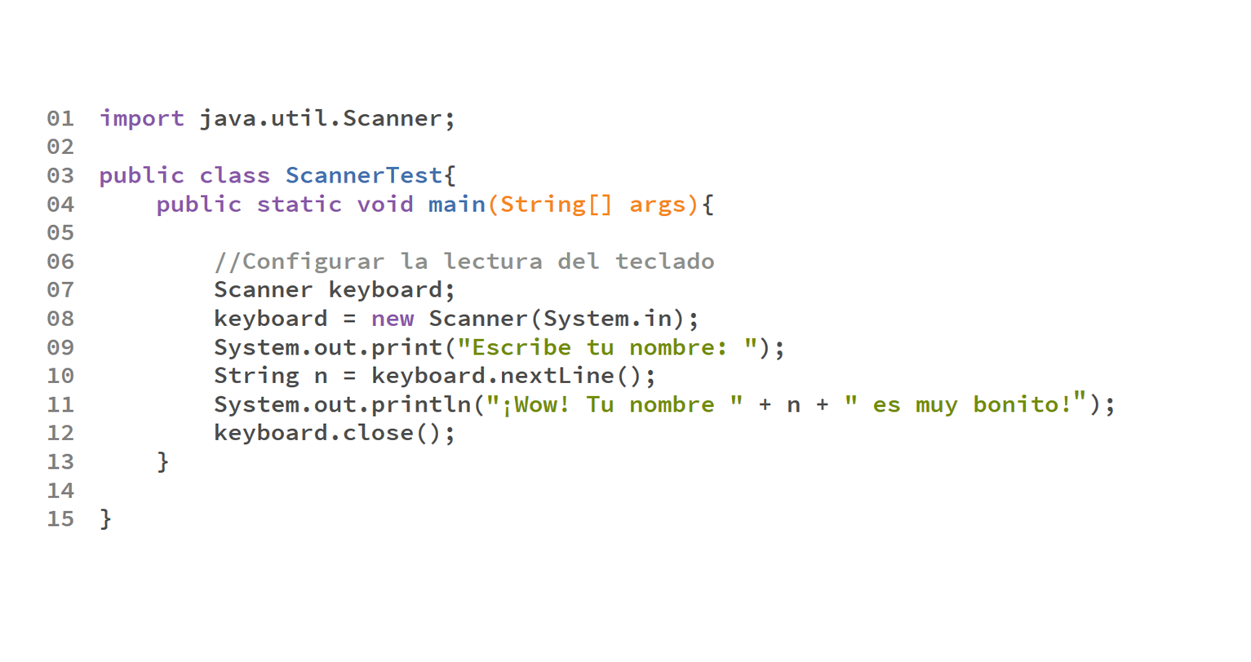

Slide 46
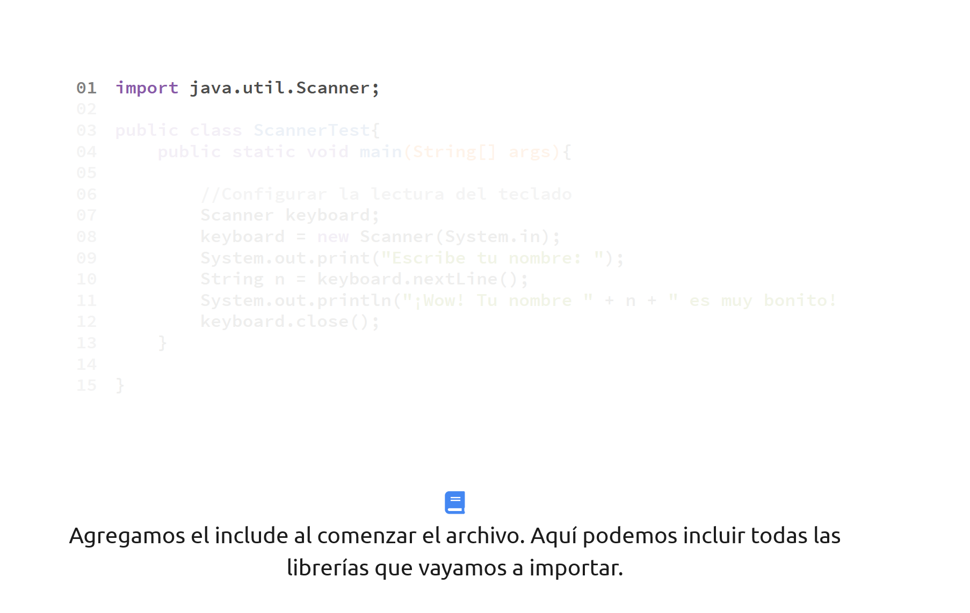

Slide 47
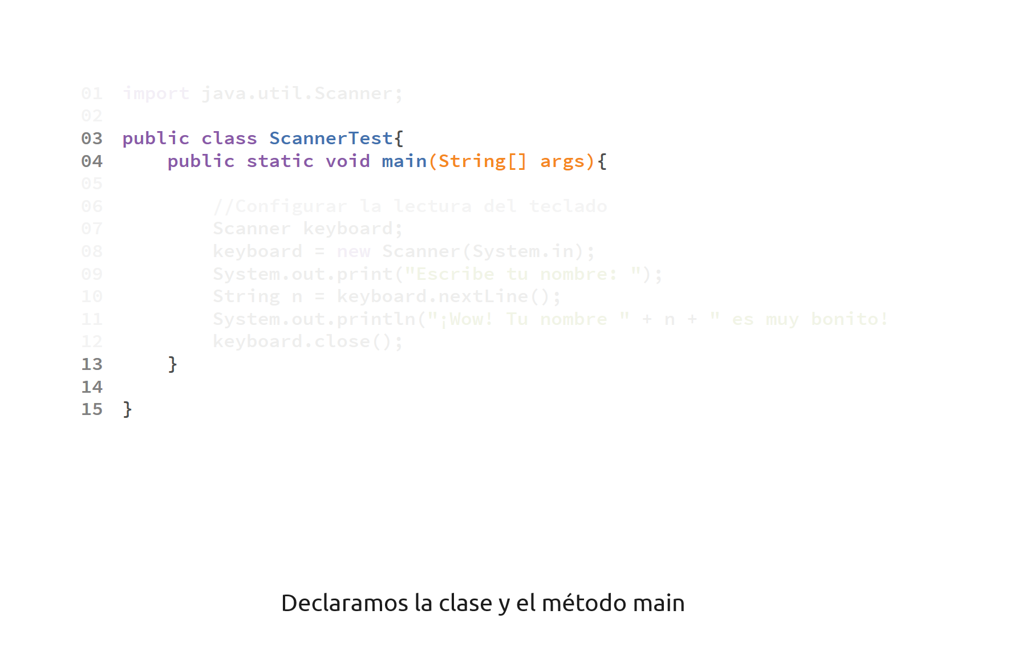

Slide 48
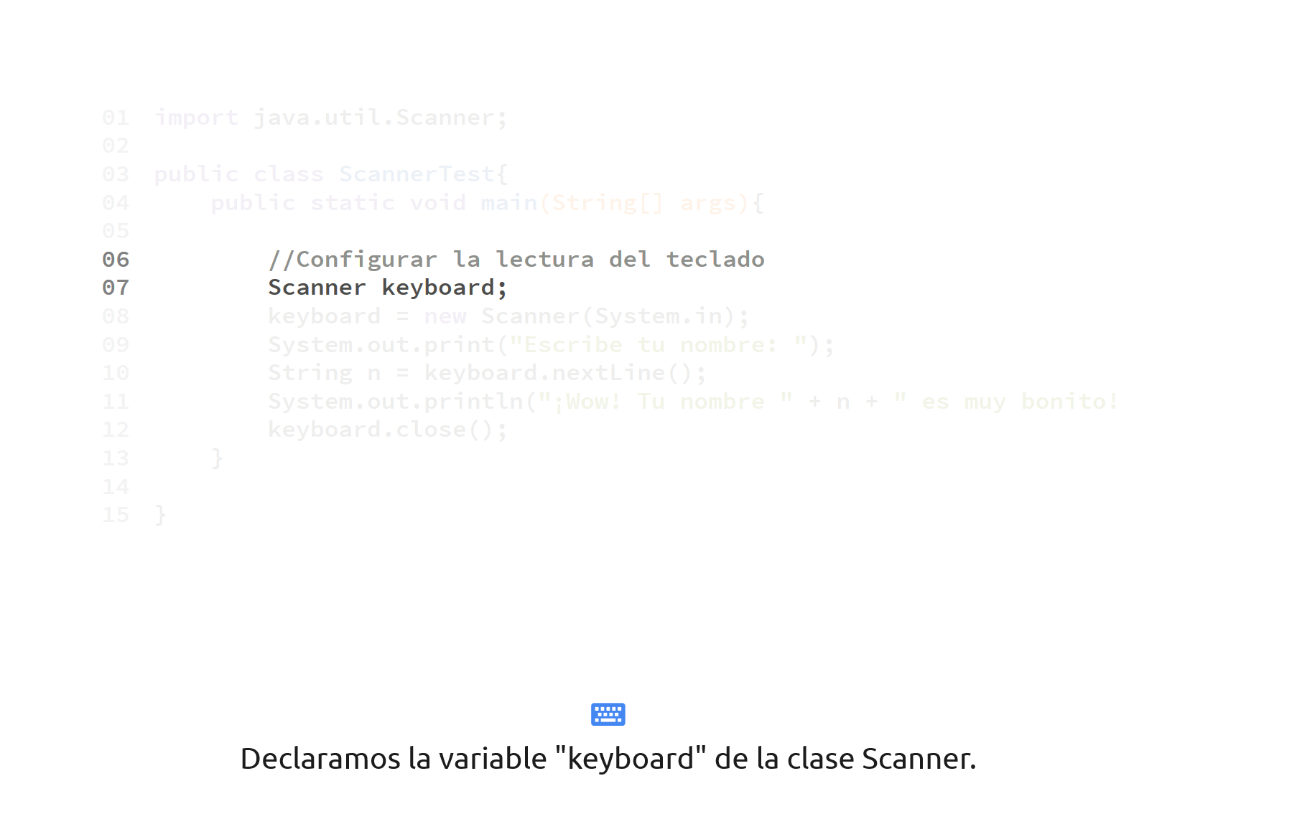

Slide 49
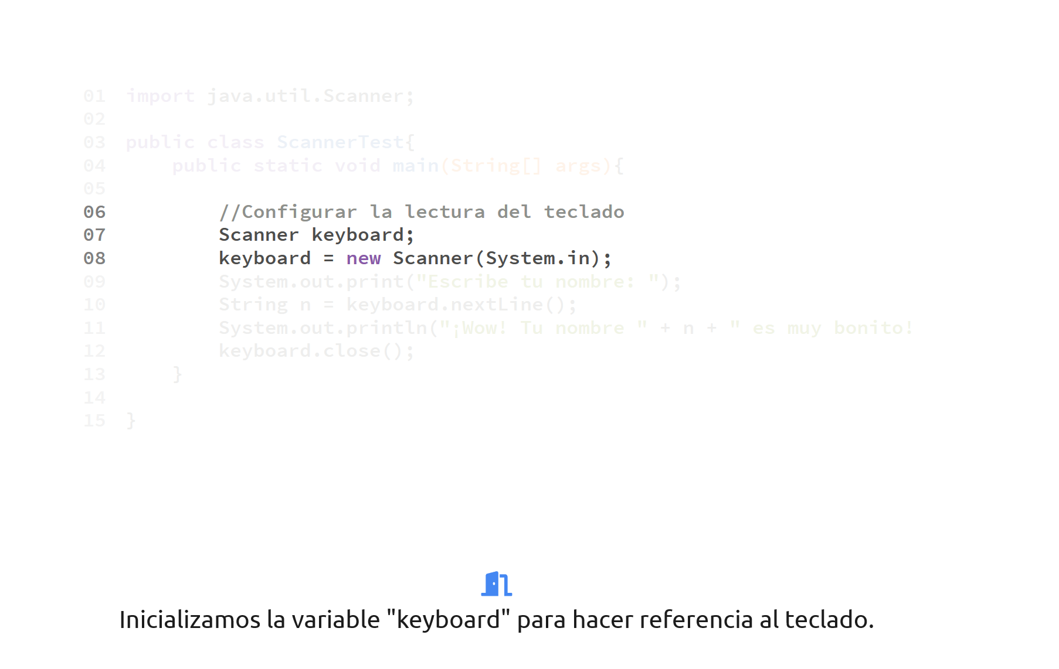

Slide 50
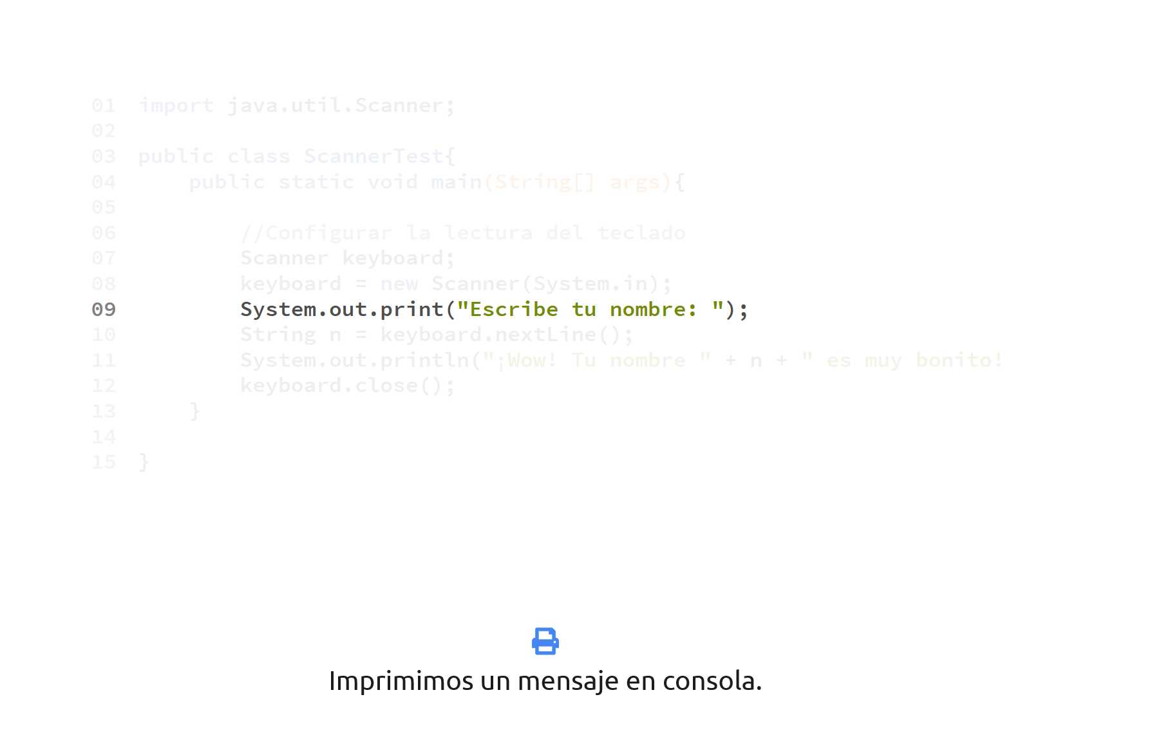

Slide 51
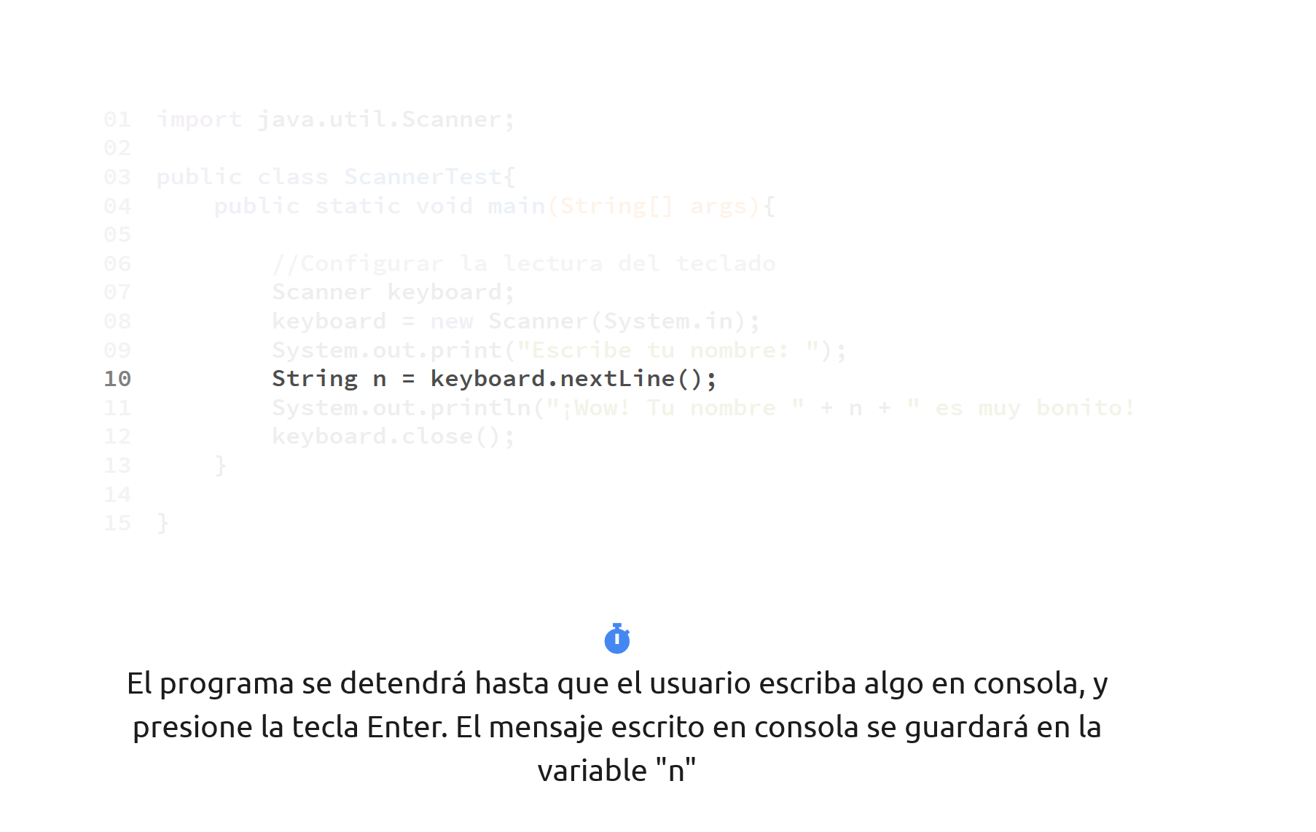

Slide 52
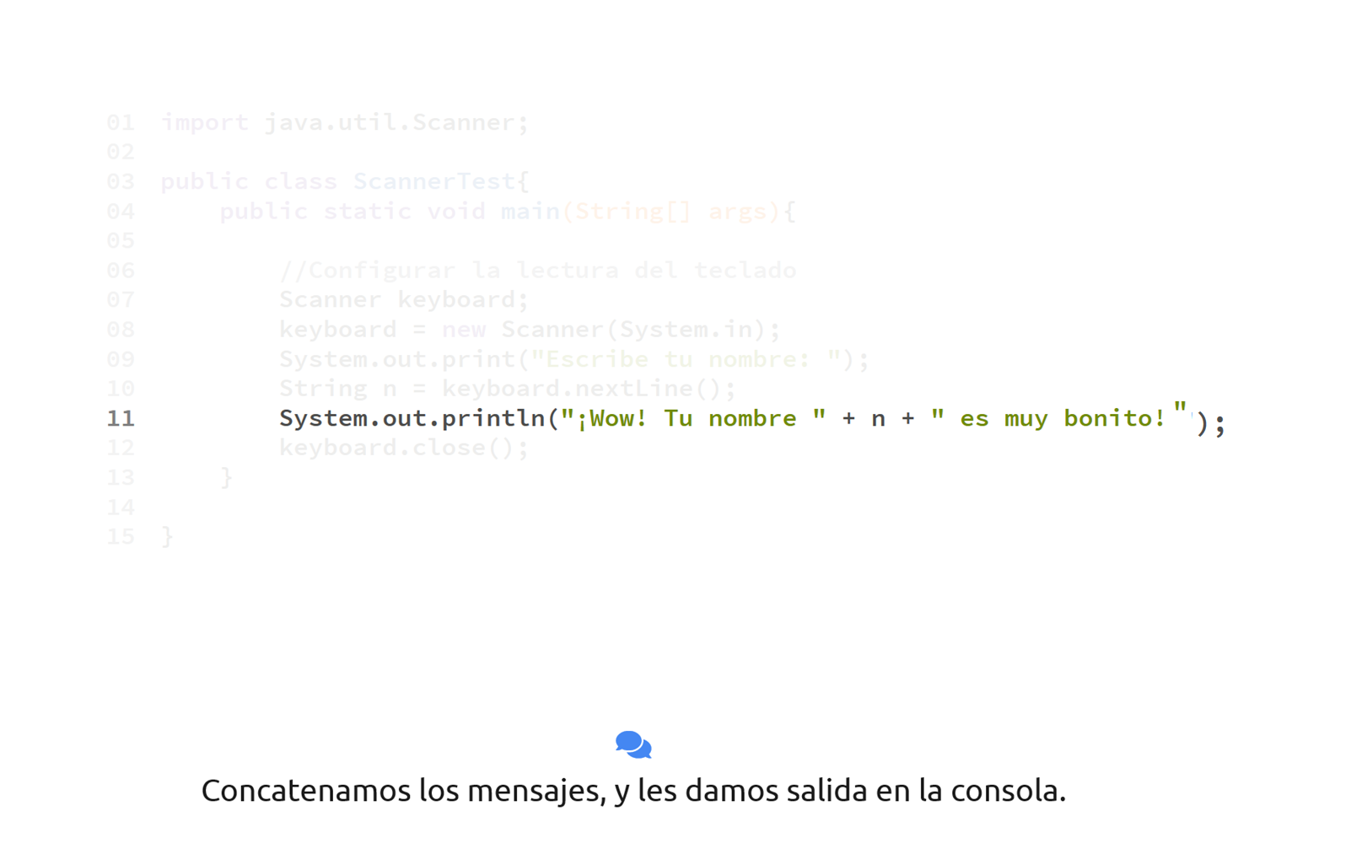

Slide 53
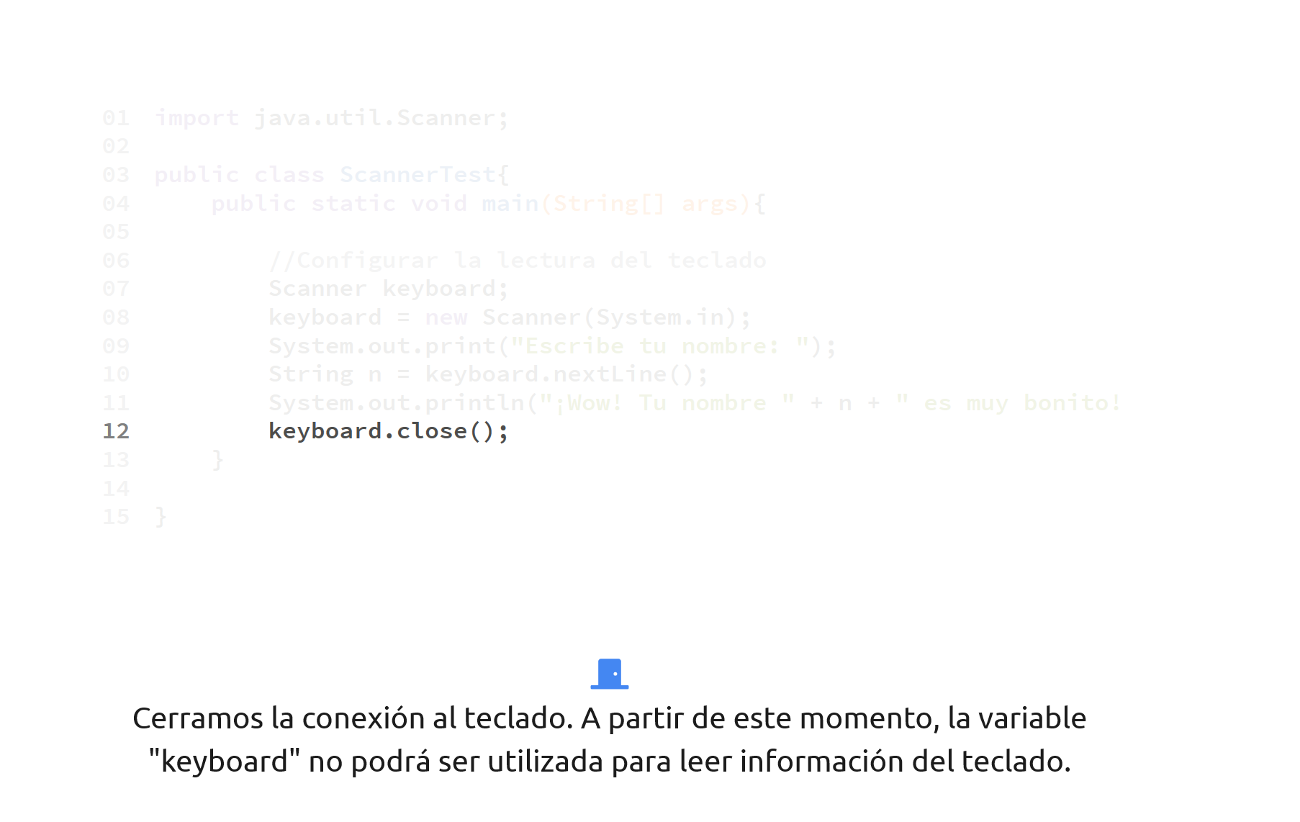

Slide 55
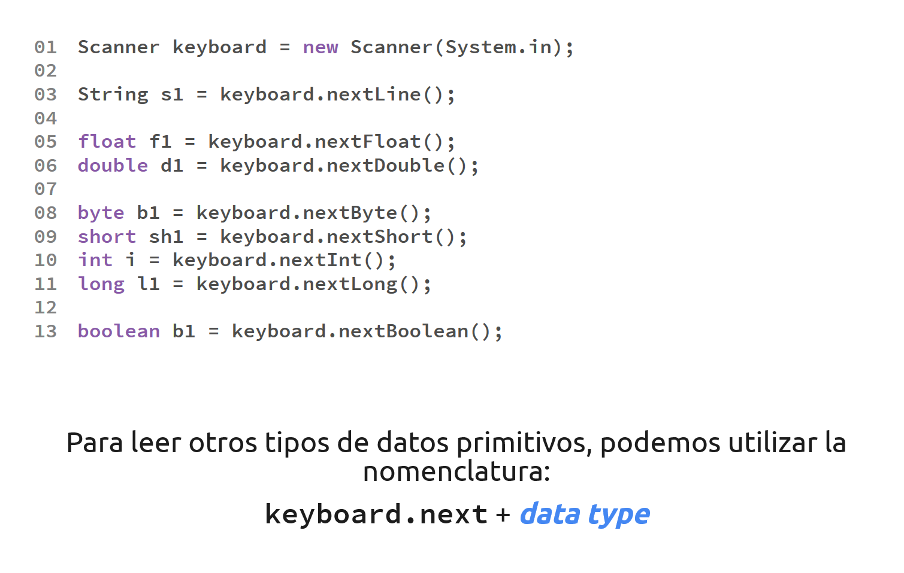

Slide 56
Operadores Incrementales y Decrementales

Slide 57
Operadores Incrementales y Decrementales
Hay instrucciones especiales en Java que nos permiten incrementar o decrementar el valor de una variable en 1. Estos se identifican mediante ++ y --.
Operator | Use | Descripción | Nombre
++ | op++ | Incrementa op en 1; evalúa el valor de op antes de incrementarlo. | Postfix increment
++ | ++op | Incrementa op en 1; evalúa el valor de op después de incrementarlo. | Prefix increment
-- | op-- | Reduce op en 1; evalúa el valor de op antes de reducirlo. | Postfix decrement
-- | --op | Reduce op en 1; evalúa el valor de op después de reducirlo. | Prefix decrement

Slide 58
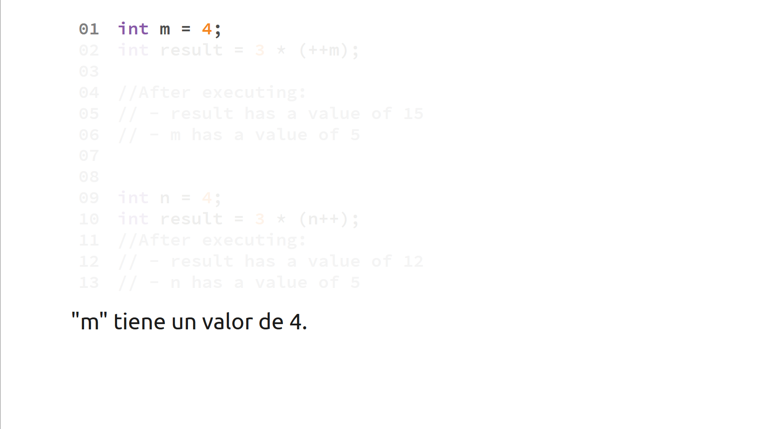

Slide 59
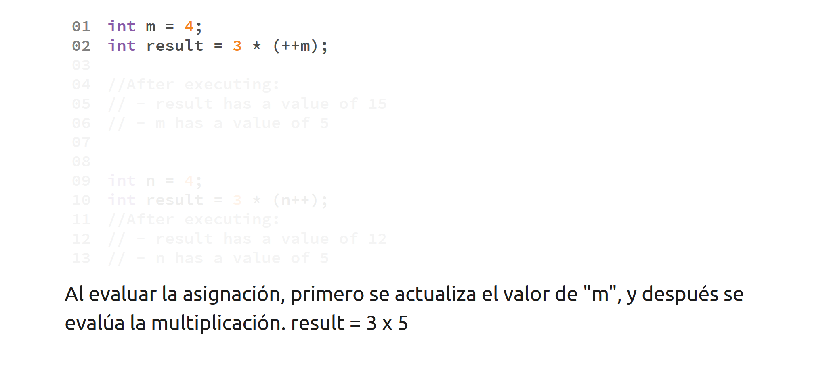

Slide 60
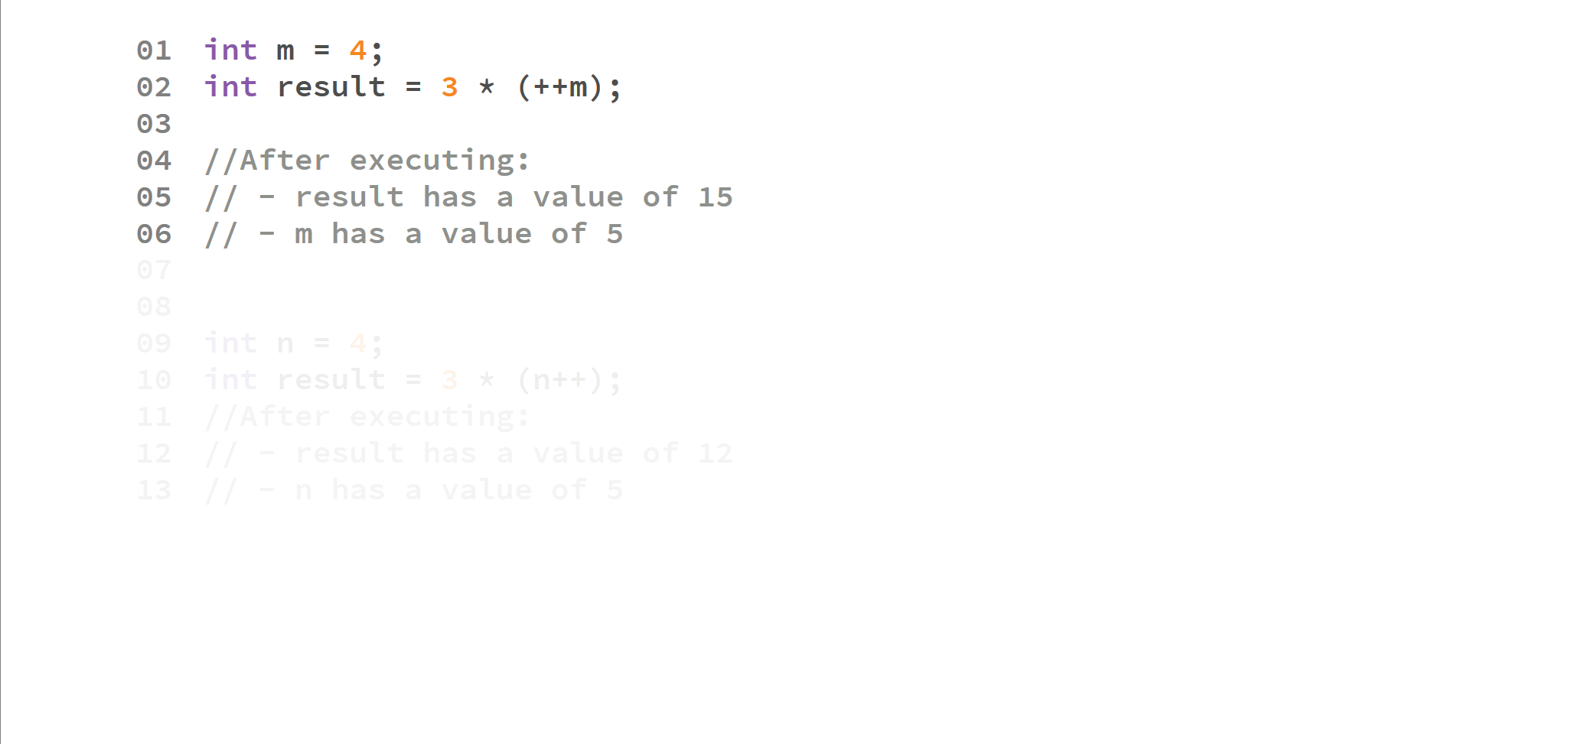

Slide 61
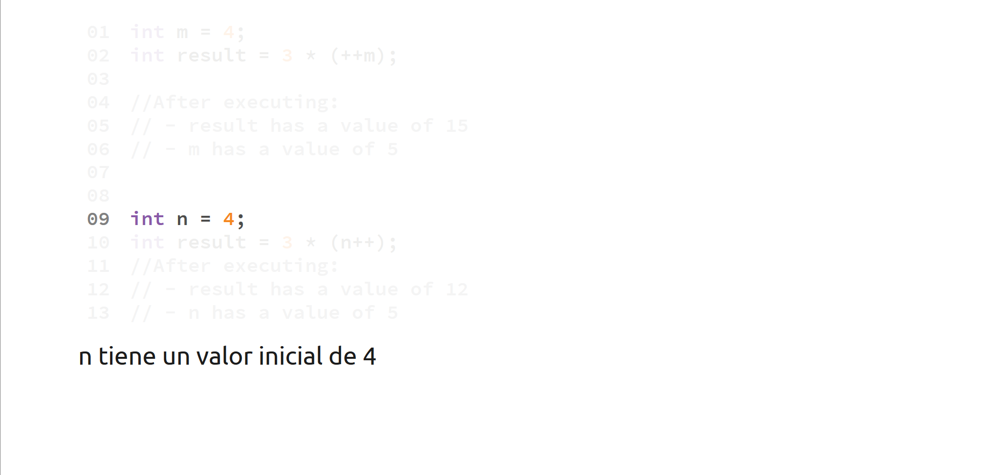

Slide 62
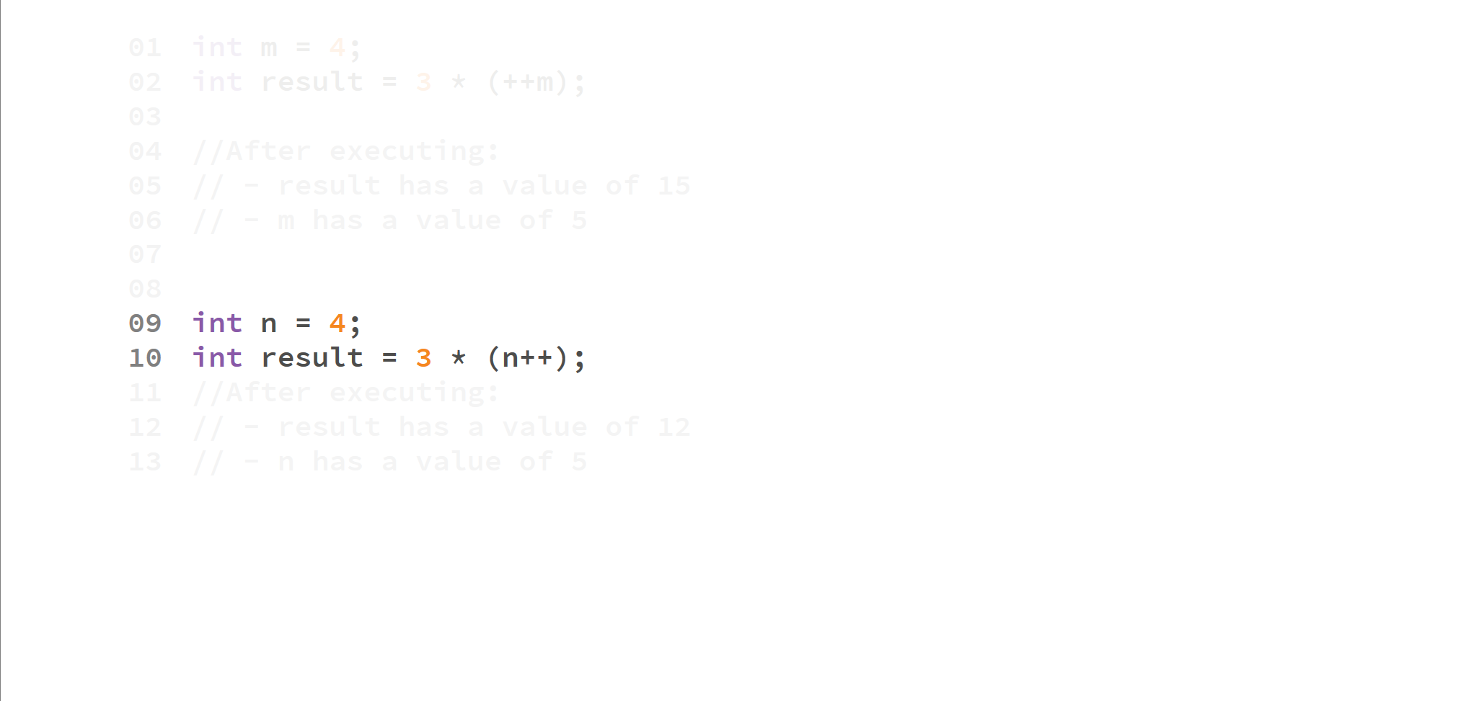

Slide 63
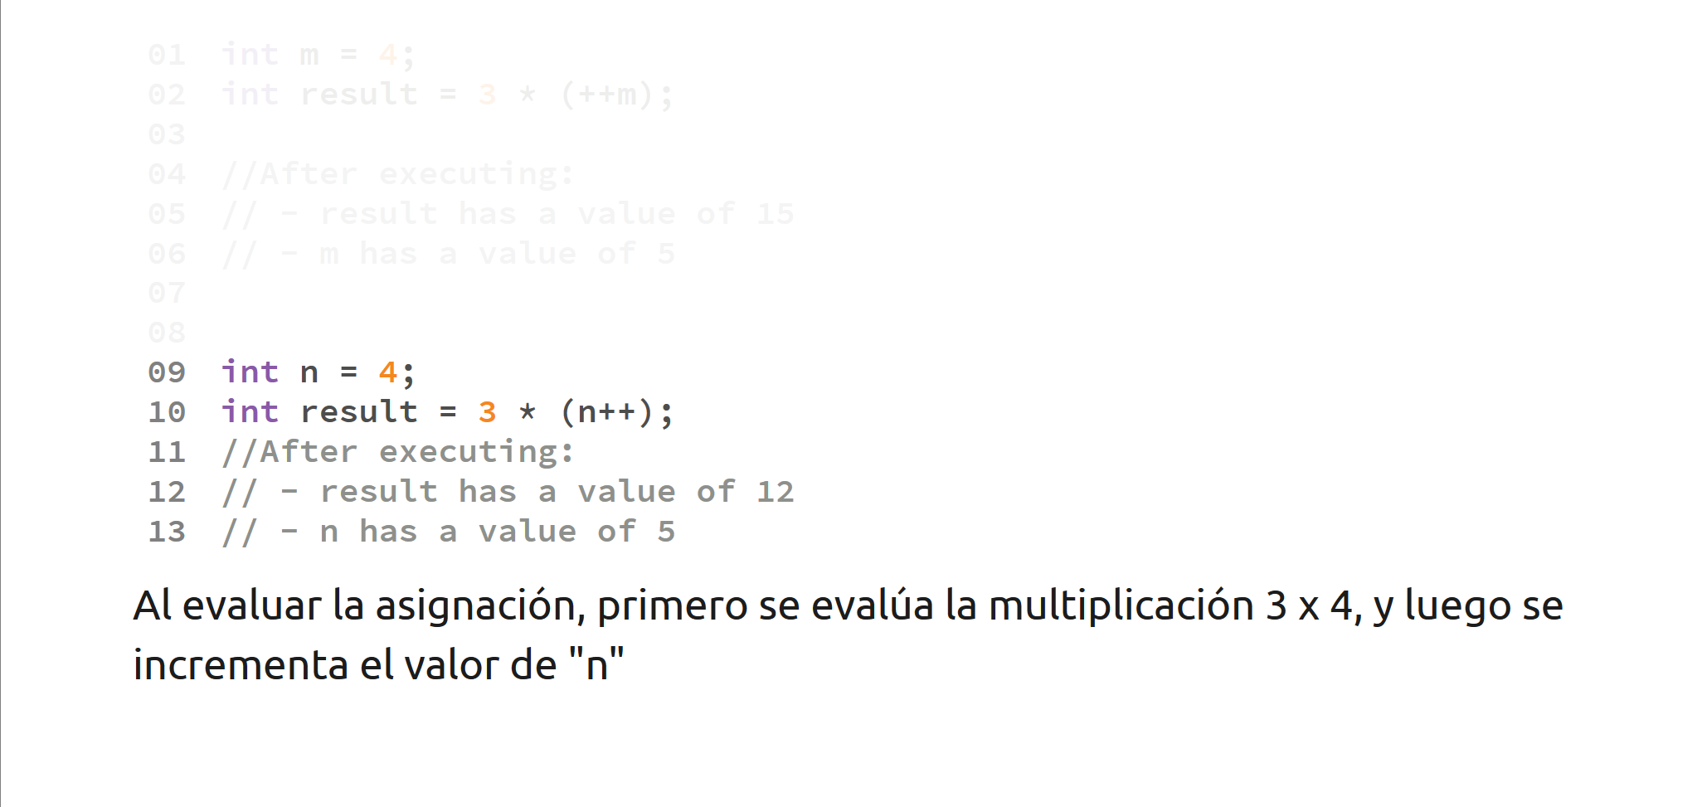

Slide 64
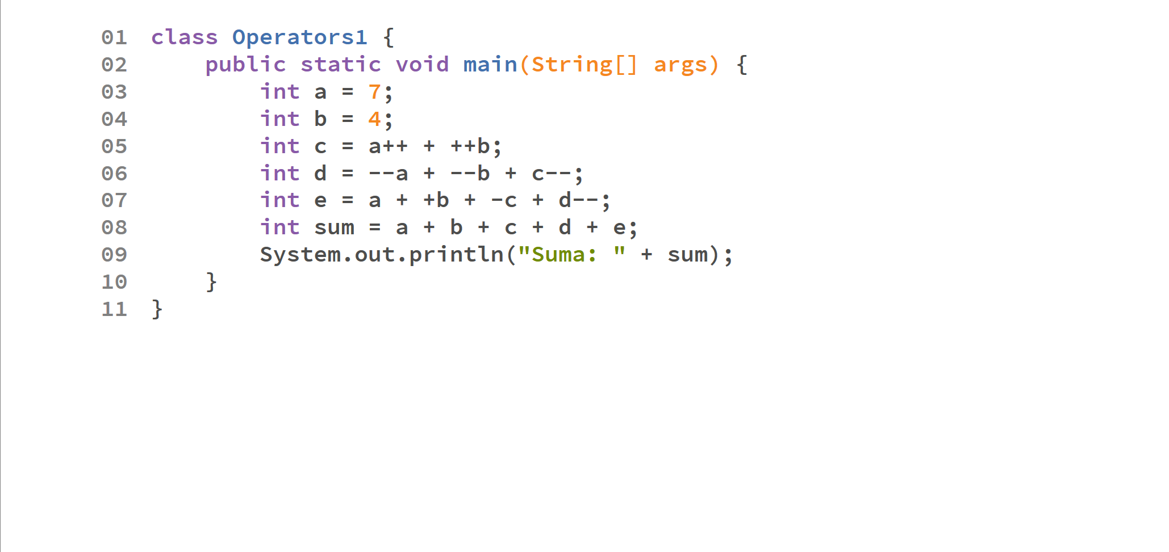

Slide 65
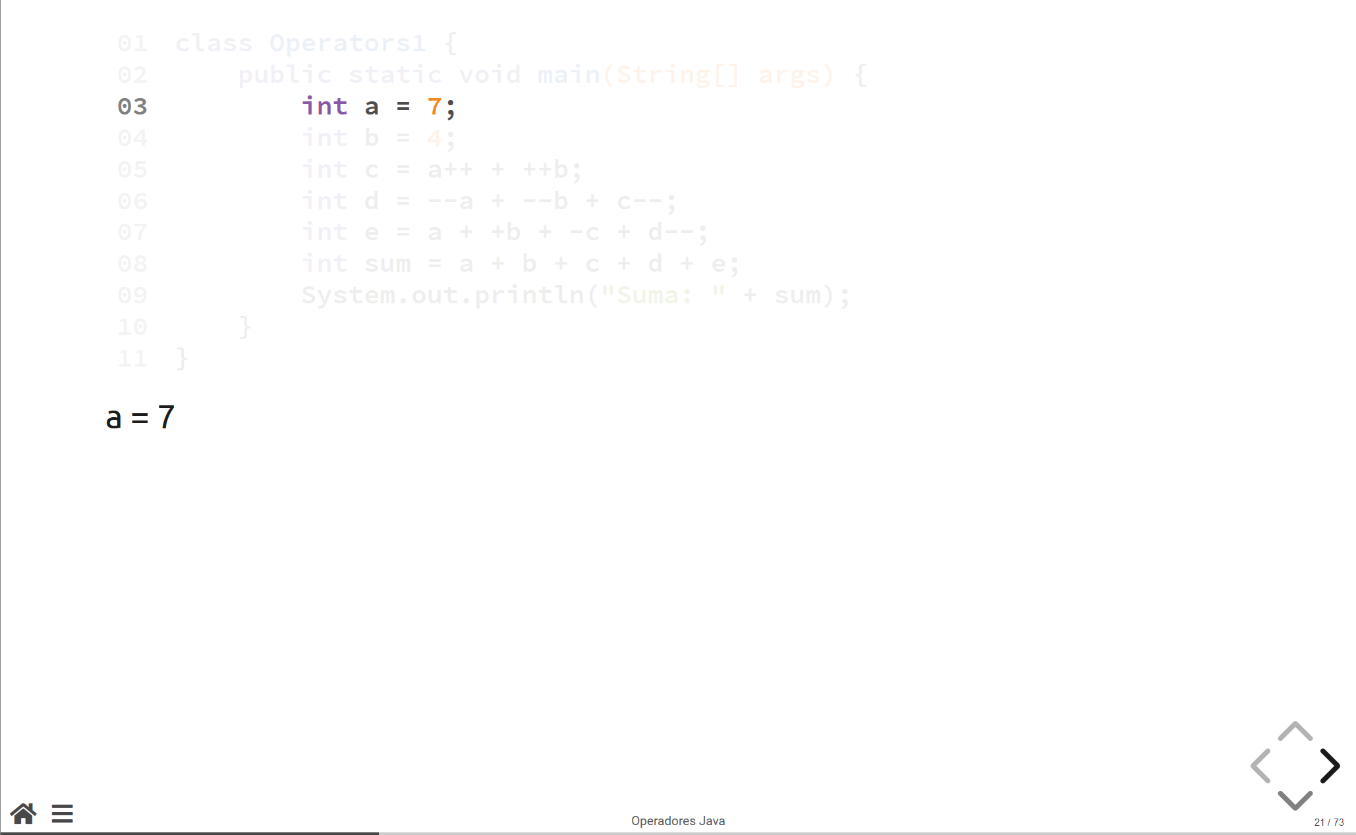

Slide 66
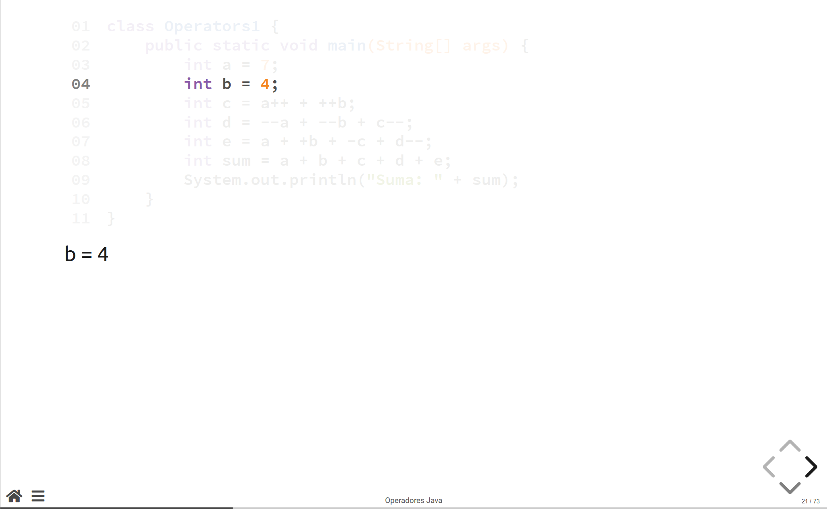

Slide 67
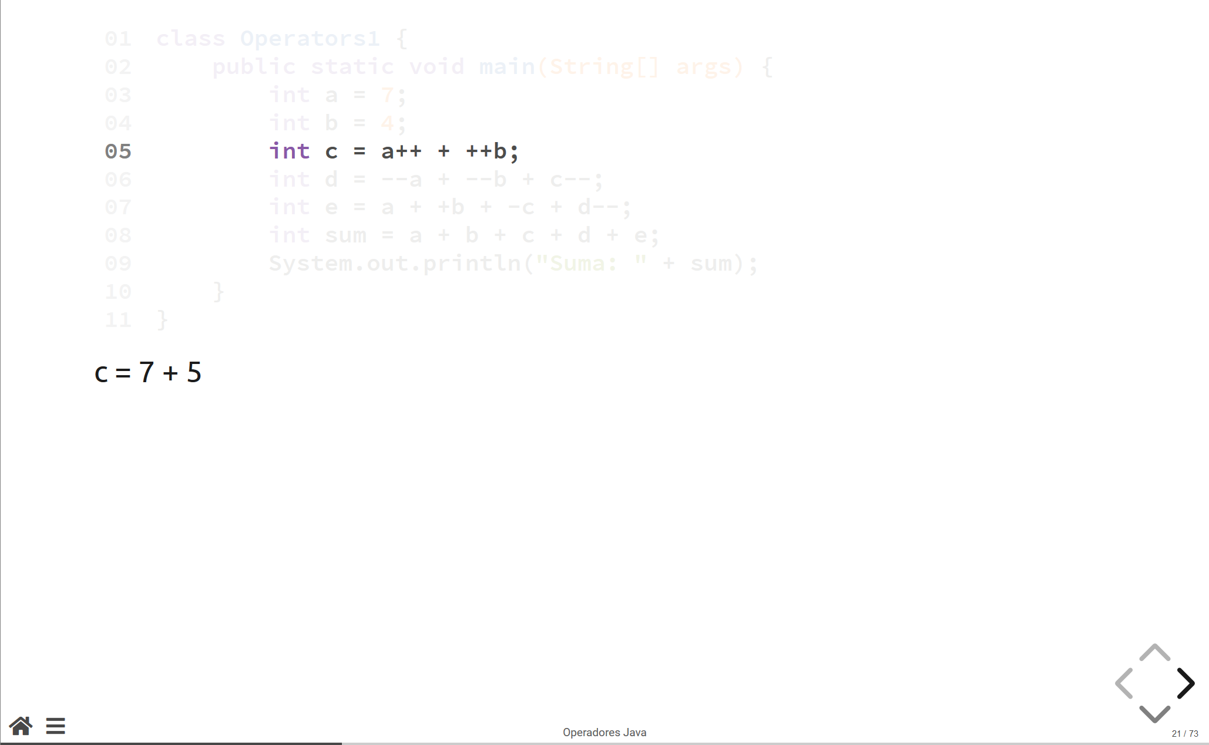

Slide 68
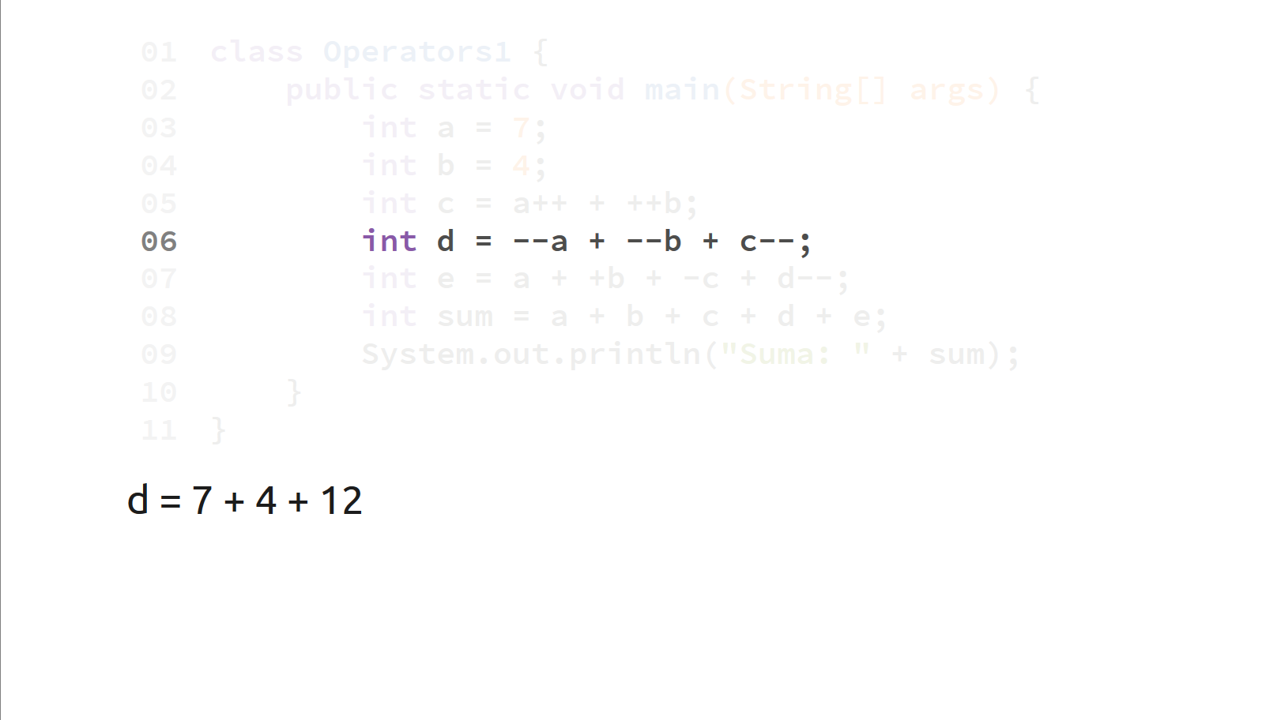

Slide 69
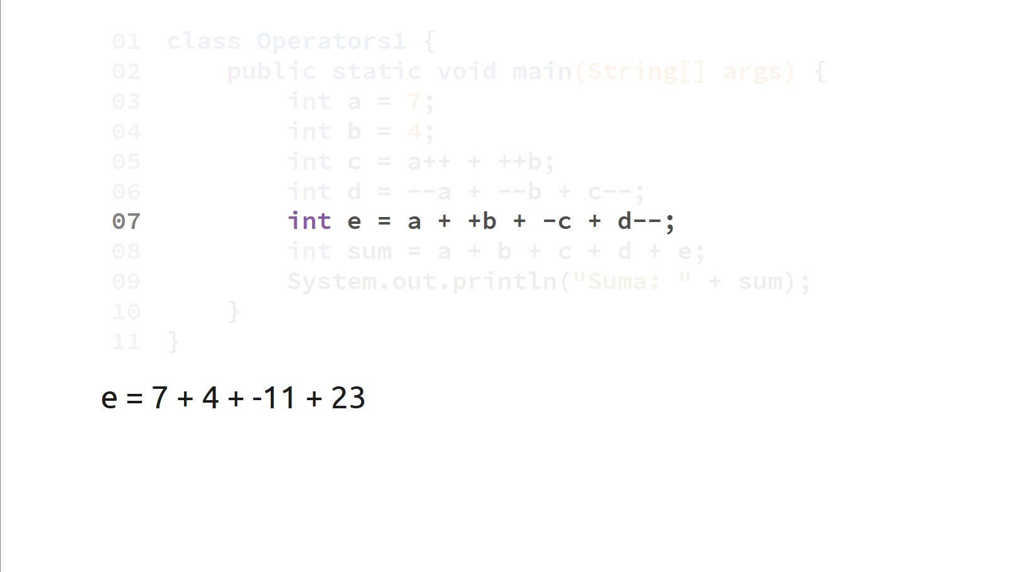

Slide 70
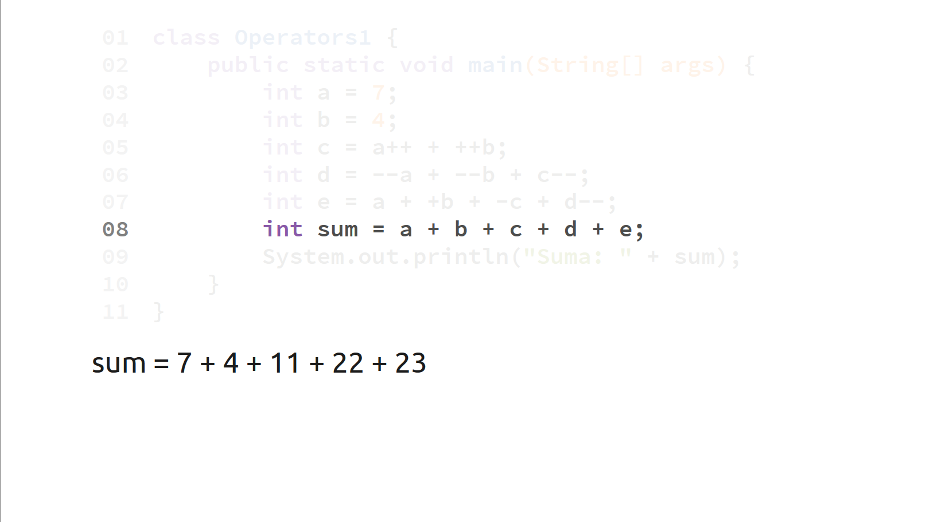

Slide 71
